Slide 1
K ČEMU VLASTNĚ JSOU DPP4 INHIBITORY?
Milan Kvapil

Slide 2
 | Nemám konflikt zájmů | Mám konflikt zájmů | Specifikace konfliktu (vyjmenujte subjekty, firmy či instituce, se kterými Vaše spolupráce může vést ke konfliktu zájmů)
Zaměstnanecký poměr | X
Vlastník / akcionář | X
Konzultant | X
Přednášková činnost | X
Člen poradních sborů (advisory boards) | X
Podpora výzkumu / granty | X
Jiné honoráře (např. za klinické studie či registry) | X

Slide 3
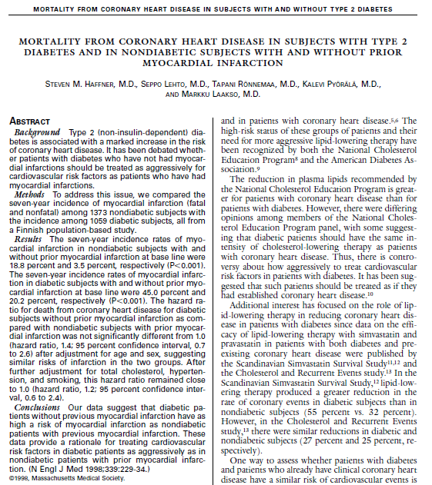
N Engl J Med 1998;339:229-34.)
Notes:
Figure 1. Kaplan–Meier Estimates of the Probability of Death from Coronary Heart Disease in 1059 Subjects
with Type 2 Diabetes and 1378 Nondiabetic Subjects with and without Prior Myocardial Infarction.
MI denotes myocardial infarction. I bars indicate 95 percent confidence intervals.

Slide 4
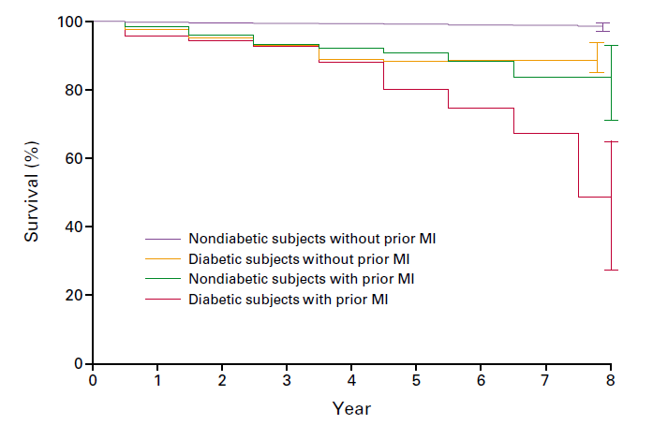
N Engl J Med 1998;339:229-34.)
Notes:
Figure 1. Kaplan–Meier Estimates of the Probability of Death from Coronary Heart Disease in 1059 Subjects
with Type 2 Diabetes and 1378 Nondiabetic Subjects with and without Prior Myocardial Infarction.
MI denotes myocardial infarction. I bars indicate 95 percent confidence intervals.

Slide 5
%
Annual mortality (%)
(ČR – population of the Czech republic;
DIA/OAD – diabetic treated with
oral antidiabetic drugs)
70 - 79 years old ČR
70 - 79 years old DIA/OAD
60 - 69 years old ČR
60 - 69 years old DIA/OAD
50 - 59 years old ČR
50 - 59 years old DIA/OAD
year

Slide 6
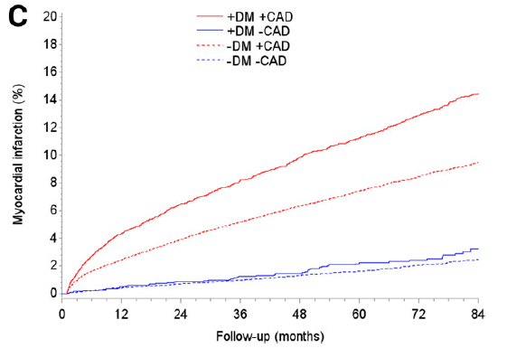
Diabetes Care 2017;40:1103–1110
Notes:
Figure 2—Accumulated rates of all-cause death (A), cardiac death (B), andmyocardial infarction (C) over 7 years in patientswith diabetes and obstructive
CAD, patients with diabeteswithout obstructive CAD, patientswithout diabeteswith obstructive CAD, and patients without diabetes without obstructive
CAD after invasive CAG. +, with; –, without; DM, diabetes.
OBJECTIVE
The risk of myocardial infarction (MI) in patients with diabetes is greater than for
patients without diabetes. Consequently, prophylactic treatment is recommended
for patients with diabetes and risk factors for ischemic heart disease. We aimed to
estimate the risk of adverse cardiac events in patients with and without diabetes
with and without coronary artery disease (CAD) after coronary angiography (CAG).
RESEARCH DESIGN AND METHODS
A population-based cohort of patients registered in the Western Denmark Heart
Registry who underwent CAG between 1 January 2003 and 31 December 2012 was
stratified according to the presence or absence of obstructive CAD and diabetes. End
points were death, cardiac death, andMI. Unadjusted and adjusted rate ratios (RRs)
were calculated by using patientswithout diabetes andwithout CAD as the reference
group.
RESULTS
We included 93,866 patients of whom 12,544 (13.4%) had diabetes at the time of
CAG. Median follow-up was 4.1 years. Patients with and without diabetes without
obstructive CAD had the same adjusted risk of death (RR 1.03 [95% CI 0.92–1.15]),
cardiac death (RR 1.21 [95% CI 0.90–1.64]), and MI (RR 0.88 [95% CI 0.65–1.17]).
Patients with diabetes without CAD were more often treated with statins (75.3% vs.
46.0%) and aspirin (65.7% vs. 52.7%) than patients without diabetes and CAD.
CONCLUSIONS
In a real-world population, patients with diabetes with high rates of statin and aspirin
treatment had the same risk of cardiovascular events as patientswithout diabetes in
the absence of angiographically significant CAD.

Slide 7
Je lhostejné, jestli máte DM nebo ne.
Pokud nemáte ICHS
Diabetes Care 2017;40:1103–1110
Notes:
Figure 2—Accumulated rates of all-cause death (A), cardiac death (B), andmyocardial infarction (C) over 7 years in patientswith diabetes and obstructive
CAD, patients with diabeteswithout obstructive CAD, patientswithout diabeteswith obstructive CAD, and patients without diabetes without obstructive
CAD after invasive CAG. +, with; –, without; DM, diabetes.
OBJECTIVE
The risk of myocardial infarction (MI) in patients with diabetes is greater than for
patients without diabetes. Consequently, prophylactic treatment is recommended
for patients with diabetes and risk factors for ischemic heart disease. We aimed to
estimate the risk of adverse cardiac events in patients with and without diabetes
with and without coronary artery disease (CAD) after coronary angiography (CAG).
RESEARCH DESIGN AND METHODS
A population-based cohort of patients registered in the Western Denmark Heart
Registry who underwent CAG between 1 January 2003 and 31 December 2012 was
stratified according to the presence or absence of obstructive CAD and diabetes. End
points were death, cardiac death, andMI. Unadjusted and adjusted rate ratios (RRs)
were calculated by using patientswithout diabetes andwithout CAD as the reference
group.
RESULTS
We included 93,866 patients of whom 12,544 (13.4%) had diabetes at the time of
CAG. Median follow-up was 4.1 years. Patients with and without diabetes without
obstructive CAD had the same adjusted risk of death (RR 1.03 [95% CI 0.92–1.15]),
cardiac death (RR 1.21 [95% CI 0.90–1.64]), and MI (RR 0.88 [95% CI 0.65–1.17]).
Patients with diabetes without CAD were more often treated with statins (75.3% vs.
46.0%) and aspirin (65.7% vs. 52.7%) than patients without diabetes and CAD.
CONCLUSIONS
In a real-world population, patients with diabetes with high rates of statin and aspirin
treatment had the same risk of cardiovascular events as patientswithout diabetes in
the absence of angiographically significant CAD.

Slide 8
Nééééééééééé
to jsou kecy

Slide 9
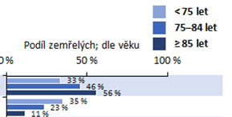
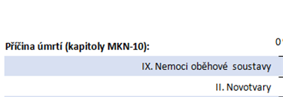

Slide 10
ATEROriziko
mrtvice
infarkt
Inzulínová rezistence
DM2T
hypertenze
dyslipidémie
Čas/věk

Slide 11
Hyperglykémie
superponuje
riziko aterosklerózy
ATEROriziko
mrtvice
infarkt
Inzulínová rezistence
DM2T
hypertenze
dyslipidémie
Čas/věk

Slide 12
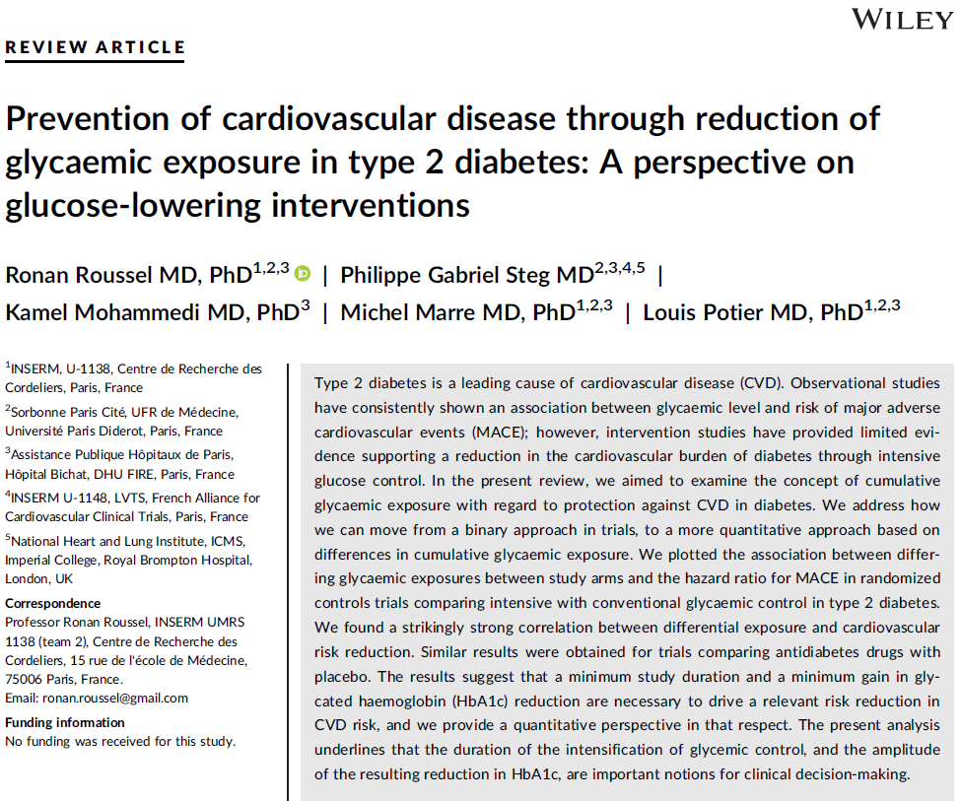

Slide 13
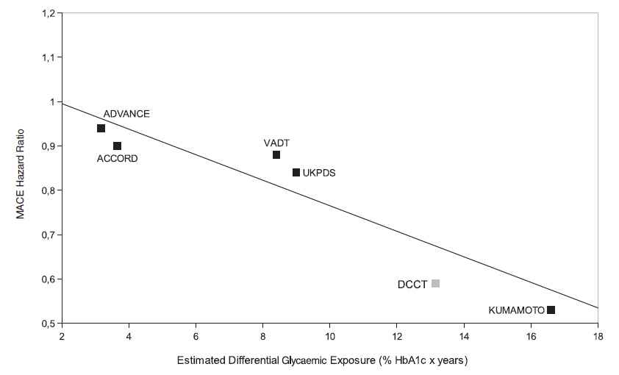
DOI: 10.1111/dom.13033
Notes:
GURE 1 Association between estimated glycaemic exposure (unit: % HbA1c year) and HR for MACE or surrogates in intensive vs
conventional glycaemia trials (ADVANCE, ACCORD, DCCT, Kumamoto, VADT, UKPDS). Owing to the unavailability of MACE HR in these
studies, the HR for myocardial infarction was used in the UKPDS, and risk ratio for reported cardiovascular events in the Kumamoto Study.
Differential glycaemic exposure was graphically estimated in each trial by calculating area between curves from baseline to median follow-up
(years) of the mean change in HbA1c (%), using a midpoint rectangle method. When HbA1c curves were not available, differential glycaemic
exposure was approximated by multiplying median HbA1c difference over the study by median length of follow-up
Type 2 diabetes is a leading cause of cardiovascular disease (CVD). Observational studies
have consistently shown an association between glycaemic level and risk of major adverse
cardiovascular events (MACE); however, intervention studies have provided limited evidence
supporting a reduction in the cardiovascular burden of diabetes through intensive
glucose control. In the present review, we aimed to examine the concept of cumulative
glycaemic exposure with regard to protection against CVD in diabetes. We address how
we can move from a binary approach in trials, to a more quantitative approach based on
differences in cumulative glycaemic exposure. We plotted the association between differing
glycaemic exposures between study arms and the hazard ratio for MACE in randomized
controls trials comparing intensive with conventional glycaemic control in type 2 diabetes.
We found a strikingly strong correlation between differential exposure and cardiovascular
risk reduction. Similar results were obtained for trials comparing antidiabetes drugs with
placebo. The results suggest that a minimum study duration and a minimum gain in glycated
haemoglobin (HbA1c) reduction are necessary to drive a relevant risk reduction in
CVD risk, and we provide a quantitative perspective in that respect. The present analysis
underlines that the duration of the intensification of glycemic control, and the amplitude
of the resulting reduction in HbA1c, are important notions for clinical decision-making.

Slide 14
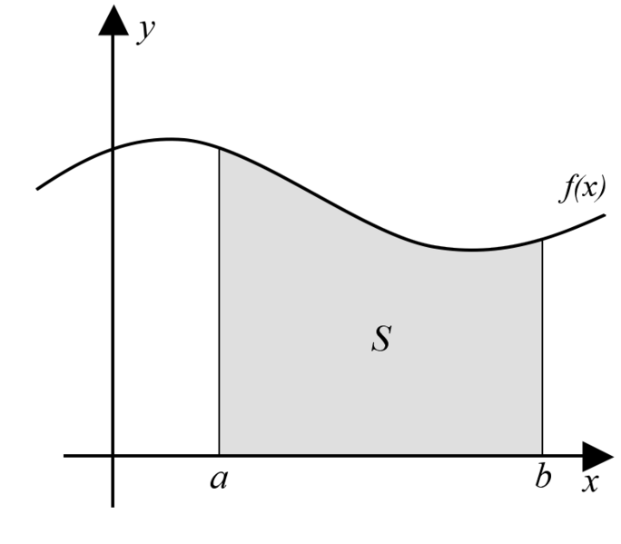
glykémie
čas

Slide 15
glykémie
čas

Slide 16
glykémie
čas

Slide 17
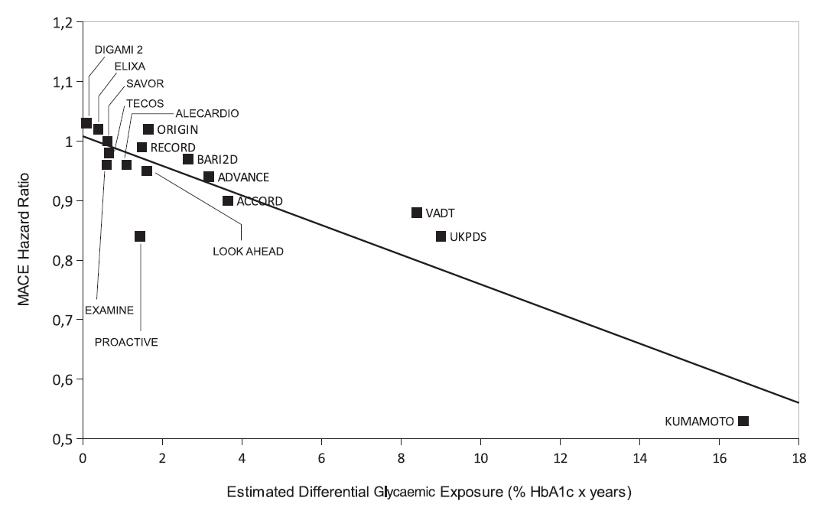
DOI: 10.1111/dom.13033
Notes:
FIGURE 2 Association between estimated glycaemic exposure (unit: % HbA1c year) and HR for MACE or surrogates in intensive vs
conventional glycaemia trials (ADVANCE, ACCORD, DCCT, DIGAMI 2, Kumamoto, VADT, UKPDS), drug vs placebo cardiovascular outcomes
trials (ALECARDIO, ELIXA, EXAMINE, ORIGIN, PRO-ACTIVE, RECORD, SAVOR, TECOS), intensive lifestyle intervention vs conventional
support (LOOK AHEAD) and insulin-providing vs insulin-sensitizing treatment strategies (BARI 2D)
Type 2 diabetes is a leading cause of cardiovascular disease (CVD). Observational studies
have consistently shown an association between glycaemic level and risk of major adverse
cardiovascular events (MACE); however, intervention studies have provided limited evidence
supporting a reduction in the cardiovascular burden of diabetes through intensive
glucose control. In the present review, we aimed to examine the concept of cumulative
glycaemic exposure with regard to protection against CVD in diabetes. We address how
we can move from a binary approach in trials, to a more quantitative approach based on
differences in cumulative glycaemic exposure. We plotted the association between differing
glycaemic exposures between study arms and the hazard ratio for MACE in randomized
controls trials comparing intensive with conventional glycaemic control in type 2 diabetes.
We found a strikingly strong correlation between differential exposure and cardiovascular
risk reduction. Similar results were obtained for trials comparing antidiabetes drugs with
placebo. The results suggest that a minimum study duration and a minimum gain in glycated
haemoglobin (HbA1c) reduction are necessary to drive a relevant risk reduction in
CVD risk, and we provide a quantitative perspective in that respect. The present analysis
underlines that the duration of the intensification of glycemic control, and the amplitude
of the resulting reduction in HbA1c, are important notions for clinical decision-making.

Slide 18
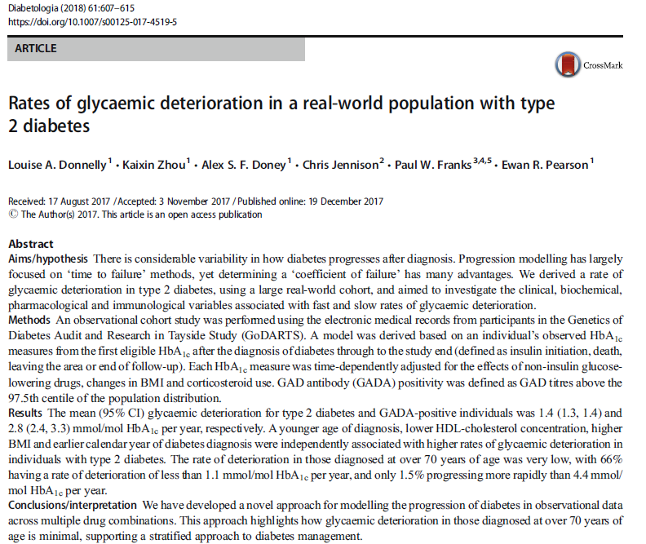
Diabetologia (2018) 61:607–615
Notes:
Fig. 1 Distribution of rate of
glycaemic deterioration (increase
in adjusted HbA1c per year
characterised in mmol/mol units),
presented as a histogram (a) and
box-and-whisker plot (b). Light
grey, type 2 diabetes; dark grey,
GADA positivity. Ranges in (a)
are from −3 to <−2; −2 to<−1 etc.
Abstract
Aims/hypothesis There is considerable variability in how diabetes progresses after diagnosis. Progression modelling has largely
focused on ‘time to failure’ methods, yet determining a ‘coefficient of failure’ has many advantages. We derived a rate of
glycaemic deterioration in type 2 diabetes, using a large real-world cohort, and aimed to investigate the clinical, biochemical,
pharmacological and immunological variables associated with fast and slow rates of glycaemic deterioration.
Methods An observational cohort study was performed using the electronic medical records from participants in the Genetics of
Diabetes Audit and Research in Tayside Study (GoDARTS). A model was derived based on an individual’s observed HbA1c
measures from the first eligible HbA1c after the diagnosis of diabetes through to the study end (defined as insulin initiation, death,
leaving the area or end of follow-up). Each HbA1c measure was time-dependently adjusted for the effects of non-insulin glucoselowering
drugs, changes in BMI and corticosteroid use. GAD antibody (GADA) positivity was defined as GAD titres above the
97.5th centile of the population distribution.
Results The mean (95% CI) glycaemic deterioration for type 2 diabetes and GADA-positive individuals was 1.4 (1.3, 1.4) and
2.8 (2.4, 3.3) mmol/mol HbA1c per year, respectively. Ayounger age of diagnosis, lower HDL-cholesterol concentration, higher
BMI and earlier calendar year of diabetes diagnosis were independently associated with higher rates of glycaemic deterioration in
individuals with type 2 diabetes. The rate of deterioration in those diagnosed at over 70 years of age was very low, with 66%
having a rate of deterioration of less than 1.1 mmol/mol HbA1c per year, and only 1.5% progressing more rapidly than 4.4 mmol/
mol HbA1c per year.
Conclusions/interpretation We have developed a novel approach for modelling the progression of diabetes in observational data
across multiple drug combinations. This approach highlights how glycaemic deterioration in those diagnosed at over 70 years of
age is minimal, supporting a stratified approach to diabetes management.

Slide 19
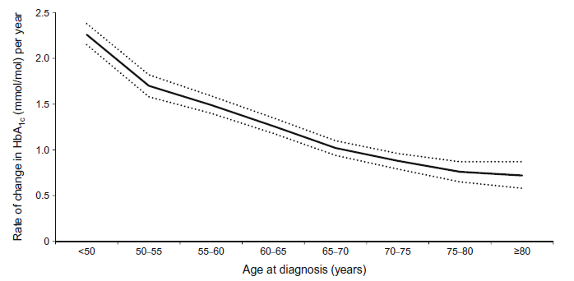
Diabetologia (2018) 61:607–615
Notes:
Fig. 2 Mean (95% CI) rate of
glycaemic deterioration (increase
in adjusted HbA1c per year
characterised in mmol/mol units),
by age at diagnosis. Ranges are
50–<55; 55–<60 etc.
Abstract
Aims/hypothesis There is considerable variability in how diabetes progresses after diagnosis. Progression modelling has largely
focused on ‘time to failure’ methods, yet determining a ‘coefficient of failure’ has many advantages. We derived a rate of
glycaemic deterioration in type 2 diabetes, using a large real-world cohort, and aimed to investigate the clinical, biochemical,
pharmacological and immunological variables associated with fast and slow rates of glycaemic deterioration.
Methods An observational cohort study was performed using the electronic medical records from participants in the Genetics of
Diabetes Audit and Research in Tayside Study (GoDARTS). A model was derived based on an individual’s observed HbA1c
measures from the first eligible HbA1c after the diagnosis of diabetes through to the study end (defined as insulin initiation, death,
leaving the area or end of follow-up). Each HbA1c measure was time-dependently adjusted for the effects of non-insulin glucoselowering
drugs, changes in BMI and corticosteroid use. GAD antibody (GADA) positivity was defined as GAD titres above the
97.5th centile of the population distribution.
Results The mean (95% CI) glycaemic deterioration for type 2 diabetes and GADA-positive individuals was 1.4 (1.3, 1.4) and
2.8 (2.4, 3.3) mmol/mol HbA1c per year, respectively. Ayounger age of diagnosis, lower HDL-cholesterol concentration, higher
BMI and earlier calendar year of diabetes diagnosis were independently associated with higher rates of glycaemic deterioration in
individuals with type 2 diabetes. The rate of deterioration in those diagnosed at over 70 years of age was very low, with 66%
having a rate of deterioration of less than 1.1 mmol/mol HbA1c per year, and only 1.5% progressing more rapidly than 4.4 mmol/
mol HbA1c per year.
Conclusions/interpretation We have developed a novel approach for modelling the progression of diabetes in observational data
across multiple drug combinations. This approach highlights how glycaemic deterioration in those diagnosed at over 70 years of
age is minimal, supporting a stratified approach to diabetes management.

Slide 20
Zlepšení o 0,7% znamená,
že se na původní hodnotu dostane
pacient až za 7 let pohodového života
Diabetologia (2018) 61:607–615
Notes:
Fig. 2 Mean (95% CI) rate of
glycaemic deterioration (increase
in adjusted HbA1c per year
characterised in mmol/mol units),
by age at diagnosis. Ranges are
50–<55; 55–<60 etc.
Abstract
Aims/hypothesis There is considerable variability in how diabetes progresses after diagnosis. Progression modelling has largely
focused on ‘time to failure’ methods, yet determining a ‘coefficient of failure’ has many advantages. We derived a rate of
glycaemic deterioration in type 2 diabetes, using a large real-world cohort, and aimed to investigate the clinical, biochemical,
pharmacological and immunological variables associated with fast and slow rates of glycaemic deterioration.
Methods An observational cohort study was performed using the electronic medical records from participants in the Genetics of
Diabetes Audit and Research in Tayside Study (GoDARTS). A model was derived based on an individual’s observed HbA1c
measures from the first eligible HbA1c after the diagnosis of diabetes through to the study end (defined as insulin initiation, death,
leaving the area or end of follow-up). Each HbA1c measure was time-dependently adjusted for the effects of non-insulin glucoselowering
drugs, changes in BMI and corticosteroid use. GAD antibody (GADA) positivity was defined as GAD titres above the
97.5th centile of the population distribution.
Results The mean (95% CI) glycaemic deterioration for type 2 diabetes and GADA-positive individuals was 1.4 (1.3, 1.4) and
2.8 (2.4, 3.3) mmol/mol HbA1c per year, respectively. Ayounger age of diagnosis, lower HDL-cholesterol concentration, higher
BMI and earlier calendar year of diabetes diagnosis were independently associated with higher rates of glycaemic deterioration in
individuals with type 2 diabetes. The rate of deterioration in those diagnosed at over 70 years of age was very low, with 66%
having a rate of deterioration of less than 1.1 mmol/mol HbA1c per year, and only 1.5% progressing more rapidly than 4.4 mmol/
mol HbA1c per year.
Conclusions/interpretation We have developed a novel approach for modelling the progression of diabetes in observational data
across multiple drug combinations. This approach highlights how glycaemic deterioration in those diagnosed at over 70 years of
age is minimal, supporting a stratified approach to diabetes management.

Slide 21
Hyperglykémie
superponuje
riziko aterosklerózy
ATEROriziko
mrtvice
infarkt
Inzulínová rezistence
DM2T
hypertenze
dyslipidémie
MET
DPP4i
Čas/věk

Slide 22
Jaká léčba diabetu bude bavit normálního člověka?
Stylovka SM?
Co nejvíce nežádoucích účinků?
Styl Neználek?
Ani o ní nevím?

Slide 23
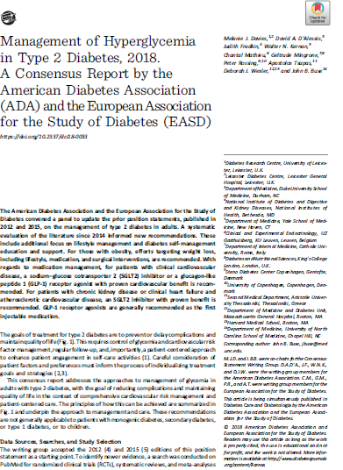
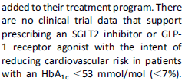

Slide 24
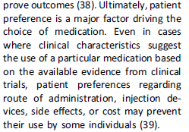

Slide 25
Gliptiny: inhibitory DPP4
Pozitiva
Dobrá účinnost,
Nezvyšují riziko hypoglykémie
Nezvyšují hmotnost
Již prověřené
Velmi dobrá compliance
Vhodné k metforminu

Slide 26
Gliptiny: inhibitory DPP4
Pozitiva
Dobrá účinnost,
Nezvyšují riziko hypoglykémie
Nezvyšují hmotnost
Již prověřené
Velmi dobrá compliance
Vhodné k metforminu
Negativa
Minimální

Slide 27
Racionální výběr farmakoterapie

Slide 28
Racionální výběr farmakoterapie
Léčba hyperglykémie

Slide 29
Racionální výběr farmakoterapie
Léčba hyperglykémie
Prevence kardiovaskulárních komplikací

Slide 30
Ano, potřebujeme gliptiny….
Pro dobrou complianci, kdy snížením glykémie oddálíme všechny komplikace
Pro křehké pacienty
Pro non-compliantní nemocné
Pro spoluobčany vyššího věku, u nichž „tvrdá data ze studií nemáme k dispozici, a kteří mohou mít před sebou ještě řadu let věku
Protože intenzivní léčba od začátku snižuje i pravděpodobnost srdečního selhání….

Slide 31
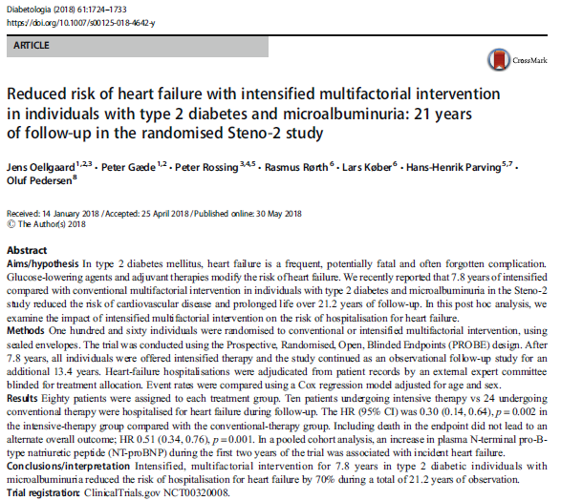
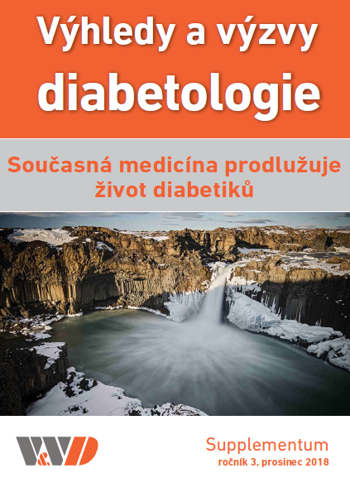
Diabetologia (2018) 61:1724–1733
Notes:
Abstract
Aims/hypothesis In type 2 diabetes mellitus, heart failure is a frequent, potentially fatal and often forgotten complication.
Glucose-lowering agents and adjuvant therapies modify the risk of heart failure.We recently reported that 7.8 years of intensified
compared with conventional multifactorial intervention in individuals with type 2 diabetes and microalbuminuria in the Steno-2
study reduced the risk of cardiovascular disease and prolonged life over 21.2 years of follow-up. In this post hoc analysis, we
examine the impact of intensified multifactorial intervention on the risk of hospitalisation for heart failure.
Methods One hundred and sixty individuals were randomised to conventional or intensified multifactorial intervention, using
sealed envelopes. The trial was conducted using the Prospective, Randomised, Open, Blinded Endpoints (PROBE) design. After
7.8 years, all individuals were offered intensified therapy and the study continued as an observational follow-up study for an
additional 13.4 years. Heart-failure hospitalisations were adjudicated from patient records by an external expert committee
blinded for treatment allocation. Event rates were compared using a Cox regression model adjusted for age and sex.
Results Eighty patients were assigned to each treatment group. Ten patients undergoing intensive therapy vs 24 undergoing
conventional therapy were hospitalised for heart failure during follow-up. The HR (95% CI) was 0.30 (0.14, 0.64), p = 0.002 in
the intensive-therapy group compared with the conventional-therapy group. Including death in the endpoint did not lead to an
alternate overall outcome; HR 0.51 (0.34, 0.76), p = 0.001. In a pooled cohort analysis, an increase in plasma N-terminal pro-Btype
natriuretic peptide (NT-proBNP) during the first two years of the trial was associated with incident heart failure.
Conclusions/interpretation Intensified, multifactorial intervention for 7.8 years in type 2 diabetic individuals with
microalbuminuria reduced the risk of hospitalisation for heart failure by 70% during a total of 21.2 years of observation.

Slide 32
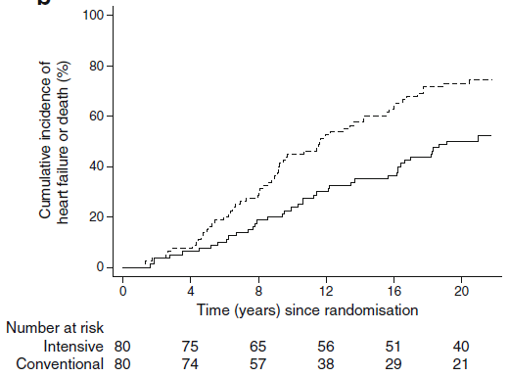
p = 0,001
Diabetologia (2018) 61:1724–1733
Notes:
Fig. 3 CIF plots of the secondary outcomes. Dashed line, conventional
therapy; solid line, intensive therapy. (a) Heart failure or cardiovascular
death. The unadjusted relative hazard reduction was 61%in the intensivetherapy
group. Logrank p < 0.001. (b) Heart failure or death from all
causes. The unadjusted relative hazard reduction was 48% in the intensive-
therapy group. Logrank p = 0.001
Fig. 2 CIF plot of hospitalisation for heart failure. Dashed line, conventional
therapy; solid line, intensive therapy. The unadjusted relative hazard
reduction was 69% in the intensive-therapy group. Logrank p = 0.001

Slide 33
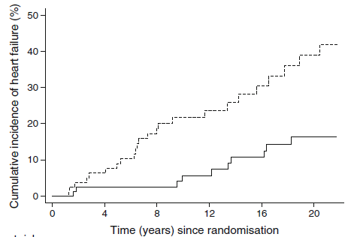
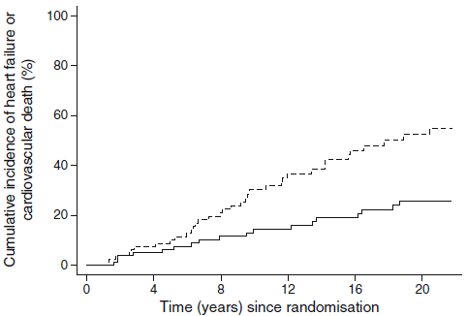
p = 0,001
Diabetologia (2018) 61:1724–1733
Notes:
Fig. 3 CIF plots of the secondary outcomes. Dashed line, conventional
therapy; solid line, intensive therapy. (a) Heart failure or cardiovascular
death. The unadjusted relative hazard reduction was 61%in the intensivetherapy
group. Logrank p < 0.001. (b) Heart failure or death from all
causes. The unadjusted relative hazard reduction was 48% in the intensive-
therapy group. Logrank p = 0.001
Fig. 2 CIF plot of hospitalisation for heart failure. Dashed line, conventional
therapy; solid line, intensive therapy. The unadjusted relative hazard
reduction was 69% in the intensive-therapy group. Logrank p = 0.001

Slide 34
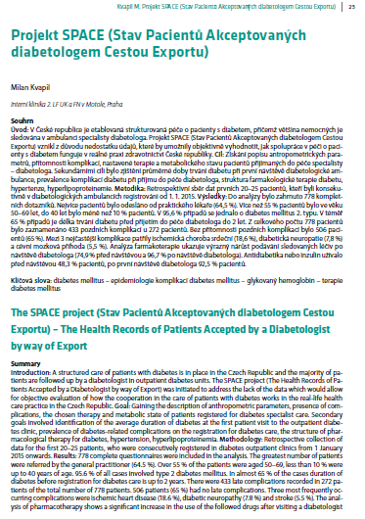
Graf 3
HbA1c – pacienti odeslaní praktickým lékařem (N = 502)
% pacientů
HbA1c (mmol/mol)
Notes:
Graf 3. Distribuce hodnot glykovaného hemoglobinu (HbA1c) odeslaných do diabetologické ordinace praktickým lékařem. První vyšetření v diabetologické ordinaci.

Slide 35
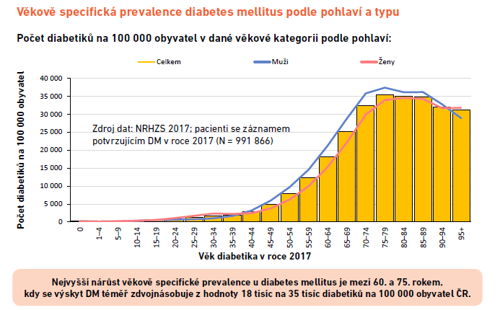
Věk | N | Průměr (SD) | Medián (IQR)
Muži | 476 194 | 65 (13) | 66 (58; 73)
Ženy | 494 256 | 68 (14) | 70 (61; 77)
Celkem ČR | 970 450 | 66 (14) | 68 (60; 75)

Slide 36
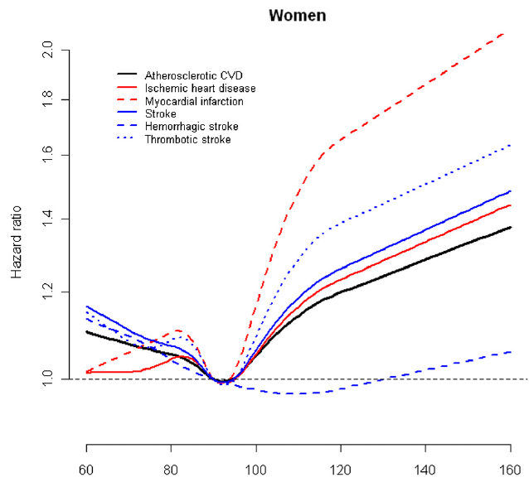
7 mmol/l
Diabetes Care 36:1988–1993, 2013
Notes:
Figure 2dHRs for cardiovascular outcomes by fasting serum glucose levels in female participants
of the KCPS. To convert glucose from mg/dL to mmol/L, multiply by 0.0555.
OBJECTIVEdAlthough diabetes increases the risk of cardiovascular disease (CVD) and mortality,
the dose-response relationship between fasting glucose levels below those diagnostic of
diabetes with cardiovascular events has not been well characterized.
RESEARCH DESIGN ANDMETHODSdA prospective cohort study of more than one
million Koreans was conducted with a mean follow-up of 16 years. A total of 1,197,384 Korean
adults with no specific medical conditions diagnosed were classified by baseline fasting serum
glucose level. Associations of fasting glucose level with CVD incidence and mortality, stroke
incidence and mortality, and all-cause mortality were analyzed using multivariate proportional
hazards regression.
RESULTSdThe relationships between fasting glucose levels and CVD risks generally followed
J-shape curves, with lowest risk in the glucose range of 85–99 mg/dL. As fasting glucose levels
increased to .100 mg/dL, risks for CVD, ischemic heart disease, myocardial infarction, and
thrombotic stroke progressively increased, but risk for hemorrhagic stroke did not. Fasting
glucose levels ,70 mg/dL were associated with increased risk of all stroke (hazard ratio 1.06,
95% CI 1.01–1.11) in men and (hazard ratio 1.11, 1.05–1.17) in women.
CONCLUSIONSdBoth low glucose level and impaired fasting glucose should be considered
as predictors of risk for stroke and coronary heart disease. The fasting glucose level associated
with the lowest cardiovascular risk may be in a narrow range.

Slide 37
Děkuji za pozornost

Slide 38
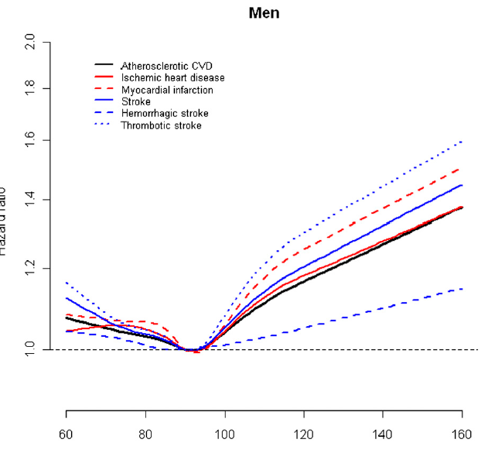
7 mmol/l
Diabetes Care 36:1988–1993, 2013
Notes:
Figure 1dHRs for cardiovascular outcomes by fasting serum glucose levels in male participants
of the KCPS. To convert glucose from mg/dL to mmol/L, multiply by 0.0555.
OBJECTIVEdAlthough diabetes increases the risk of cardiovascular disease (CVD) and mortality,
the dose-response relationship between fasting glucose levels below those diagnostic of
diabetes with cardiovascular events has not been well characterized.
RESEARCH DESIGN ANDMETHODSdA prospective cohort study of more than one
million Koreans was conducted with a mean follow-up of 16 years. A total of 1,197,384 Korean
adults with no specific medical conditions diagnosed were classified by baseline fasting serum
glucose level. Associations of fasting glucose level with CVD incidence and mortality, stroke
incidence and mortality, and all-cause mortality were analyzed using multivariate proportional
hazards regression.
RESULTSdThe relationships between fasting glucose levels and CVD risks generally followed
J-shape curves, with lowest risk in the glucose range of 85–99 mg/dL. As fasting glucose levels
increased to .100 mg/dL, risks for CVD, ischemic heart disease, myocardial infarction, and
thrombotic stroke progressively increased, but risk for hemorrhagic stroke did not. Fasting
glucose levels ,70 mg/dL were associated with increased risk of all stroke (hazard ratio 1.06,
95% CI 1.01–1.11) in men and (hazard ratio 1.11, 1.05–1.17) in women.
CONCLUSIONSdBoth low glucose level and impaired fasting glucose should be considered
as predictors of risk for stroke and coronary heart disease. The fasting glucose level associated
with the lowest cardiovascular risk may be in a narrow range.

Slide 39
Průběh diabetu
Rychlost vzestupu glykémie a glykohemoglobinu
Význam kkompenzace, sčítá se plocha pod křivkou vizcholesterol variace niman pickova proteinu
Statistika selhání viz amerika
Studie z dánska prevence ss, stano
Pozitiva a negativa dpp4
V nižších hodnotách glykohg účinnější než sglt
Diab kardiomyopatie
K čemu jsou – dobrá kompenzace prevenc epozdních kmplikací v iniciálním stádiu, kdy pacient netoleruje NU, nebo u starších nemocných, křehkých studie prospěchu kopenzace u starších
Citace s konsenz – terapie je řízena pacientam!!! Dát na začátek
Doba přežívání, ideál iniciace s metforminem – doplnění efektu,
Někam výsedky jaký choděj pacientri od praktick
Závěr – nekomplikoavaý na začátku k metforminu, ideální komplikkace maximální ífruktivikace teratpie

Slide 40
Rozdíl?
Intenzifikace startuje při 60 mmol/mol
Intenzifikace startuje při 52 mmol/mol

