Slide 1
Princip fyziologické stimulace Hisova svazku
Alan Bulava
Kardiocentrum, Nemocnice České Budějovice, a.s.
ZSF JU v Českých Budějovicích
LF UP Olomouc
XVIII. České a slovenské sympozium o arytmiích a trvalé kardiostimulaci, Olomouc, 7.-9.11.2021
Notes:
Pondělí 8.11.2021, Sál ATLAS, 8:30-9:30, 9:10-9:30 – 20 min

Slide 2
Deklarace konfliktu zájmů
 | Nemám konflikt zájmů | Mám konflikt zájmů | Specifikace konfliktu (vyjmenujte subjekty, firmy či instituce, se kterými Vaše spolupráce může vést ke konfliktu zájmů)
Zaměstnanecký poměr | X
Vlastník / akcionář | X
Konzultant | X
Přednášková činnost | X
Člen poradních sborů (advisory boards) | X
Podpora výzkumu / granty | X
Jiné honoráře (např. za klinické studie či registry) | X

Slide 3
Anatomie

Slide 4
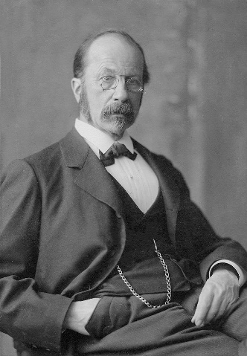
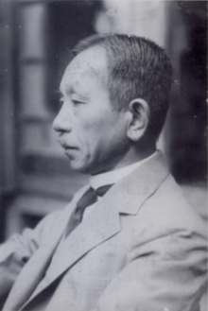
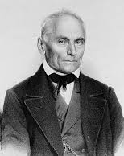
1893
1903
1846
Notes:
Anatomical characterization of the HB were first described in 1893 by Wilhelm His jr., a Swiss anatomist: Wilhelm His Jr., a Swiss anatomist, who not only as the first described the His bundle structure, but also its role in transmitting atrial impulses to the ventricles.
1903 Sunao Tawara, a Japanese pathologist: made seminal observations regarding the cardiac conduction system in 1903 revealing the existence of the AV nodal structure and making detailed observations of the His-Purkinje system (HPS).
1846 – Purkyně!
HB originates from the distal AV node, runs through the inferior portion of the membranous interventricular septum and then, in most individuals, continues along the left side of the crest of the muscular interventricular septum. The proximal part of the HB rests on the right atrial–LV portion of the membranous septum, and the more distal part travels along the RV–LV portion of the membranous septum, immediately below the aortic root

Slide 5
Stimulace Hisova svazku – historická perspektiva
Sherlag at al. poprvé popsali dočasnou stimulaci HS na psím modelu (chirurgie na otevřeném srdci)¹
První dočasná stimulace HS u lidí byla popsána Narulou et al. v r. 1970²
1977: stimulace HS může eliminovat LBBB³
První doklad o permanentní stimulaci HS u lidí v r. 2000⁴:
18 pac., 67% úspěšnost (skupina pac. s FiS a EF LKS < 40%, u nichž byla provedena ablace AV uzlu
Scherlag BJ et al. J Appl Physiol 1967: 22, 584–587
Narula OS, et al. Circulation 1970;41:77–87
Narula OS, et al. Circulation 1977; 56(6):996-1006
Deshmukh P, et al. Circulation 2000;101:869–77
Notes:
Although Narula reported in 1977 that HBP can normalize LBBB during electrophysiology study…

Slide 6
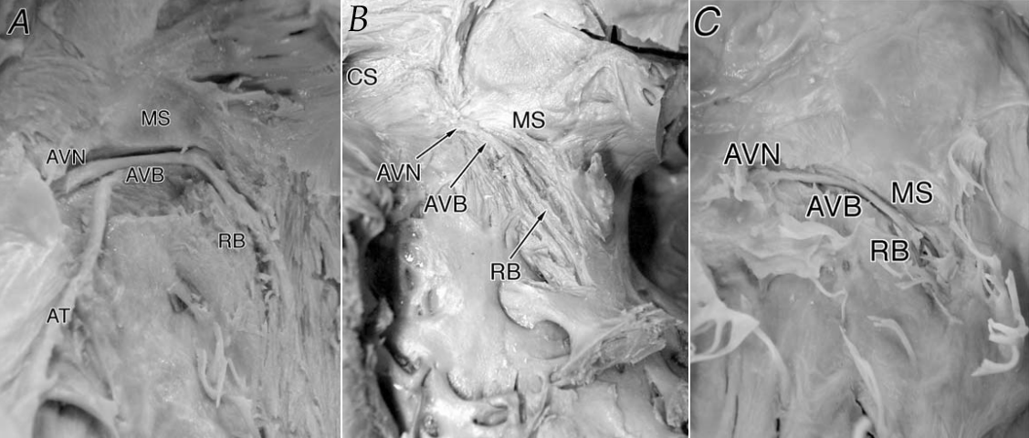
Hisův svazek – variabilní anatomie
47%
32%
21%
(A) Type 1: The His bundle (AVB) runs under the membranous part of the interventricular septum (MS). (B) The type II His bundle runs within the muscular part of the interventricular muscle apart from the lower border of the membranous part of the interventricular septum. (C) The type III His bundle (arrow) is naked running beneath the endocardium with no surrounding myocardial fibers and courses onto the membraneous part of the interven. septum
Kawashima T et al. Surgical and Radiologic Anatomy 2005; 27(3):206–213
Notes:
Recent macroscopic anatomic investigations (9) have elucidated 3 common variations of the His bundle relative to the membranous part of the ventricular septum.
In type I anatomy (the most common type, accounting for 46.7% of the hearts examined), the HB courses along the lower border of the membranous part of the interventricular
septum and is covered with only a thin layer of myocardial fibres. The second most common arrangement is the type II anatomy (32.4%), in which the HB runs within the interventricular muscle and is separated from the lower border of the membranous part of the interventricular septum. Finally, in type III anatomy (approximately 21%), also referred to as the naked AV bundle, the HB traverses immediately beneath the endocardium and courses onto the membranous part of the interventricular septum

Slide 8
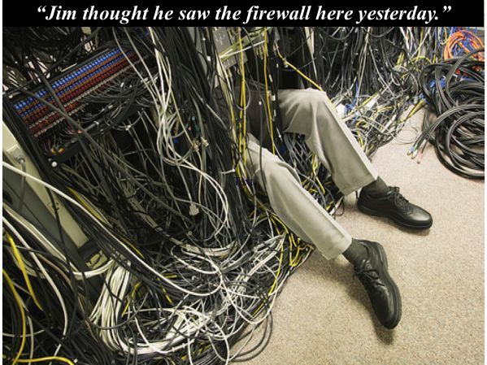
Pojmy:
HBP = His bundle pacing
CSP = conduction system pacing
LBP = left bundle pacing
NS = non-selective
S = selective
Korektivní vs. nekorektivní stimulace
Typy stimulace HS, převodního systému

Slide 9
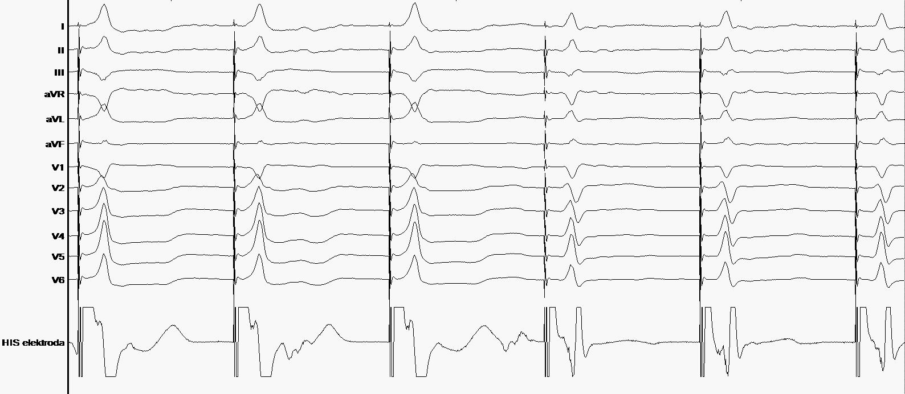
Selektivní a neselektivní stimulace HS
NS-HBP = neselektivní stimulace HS
S-HBP = selektivní stimulace HS
Notes:
1. The S-QRS interval is usually zero, as there is no isoelectric interval between pacing stimulus and QRS due to the presence of a pseudo-delta wave (due to local myocardial capture).
2. The local ventricular electrogram is directly captured by the pacing stimulus and is not seen as a discrete component.
3. The paced QRS duration will usually be longer than the native QRS duration by the H-QRS interval, and the overall electrical axis of the paced QRS will be concordant with the electrical axis of the intrinsic QRS. In patients with HPCD, the paced QRS duration may be narrower than the native QRS due to correction of underlying BBB.
4. For non-sel HBP = 2 distinct pacing thresholds (1 for his, 2 for ventricle), vs. S-HBP = 1 pacing threshold of His

Slide 10
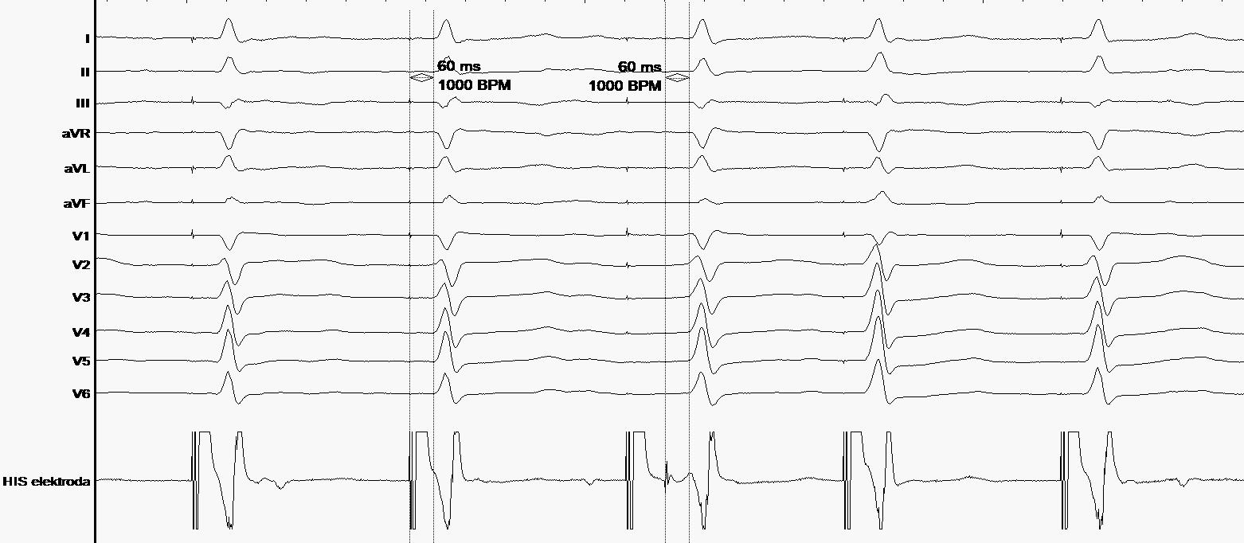
S-HBP
Ztráta stimulace
1.4 V@1ms
1,2 V@1ms
Notes:
Při NS HBP jsou dva prahy – uchvácení Hise + svaloviny, uchvácení komory, ale lze najít i variantu NS HBP a dále sel. HBP
Při S – HBP je jen jeden práh, jako zde

Slide 11
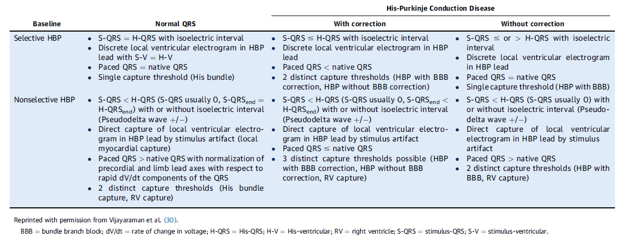
Selektivní a neselektivní stimulace HS
Vijayaraman P., Dandamudi G., Zanon F., et al. Heart Rhythm 2018;15:460–468
Notes:
Recently, a multicenter HBP collaborative working group proposed a refined set of criteria to define HBP in patients with normal His-Purkinje conduction and in those with HPCD (30). The authors broadly defined 2 forms of His bundle capture: selective capture, in which the His bundle is the only tissue captured by the pacing stimulus; and nonselective capture, in which there is fusion capture of the His bundle and adjacent ventricular tissues (Table 1). Various criteria for S-HBP or NS-HBP are described in the following text.
In patients with BBB, 3 different capture thresholds may be noted…depending on selective or nonselective His capture with correction (RV, right bundle or left bundle, and complete His bundle capture).
Utility of automatic threshold testing features is limited in HBP: due to lack of evoked potentials, this feature may fail to detect the true His capture threshold.
Importantly, additional training of the device clinic personnel is necessary to ensure appropriate programming during follow-up.

Slide 12
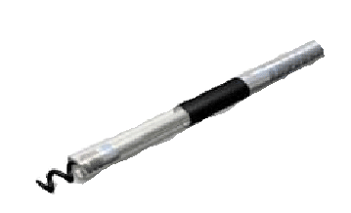
Typ anatomie ovlivňuje výsledky
NS-HBP při vyšších výdejích
a S-HBP při nižších
NS-HBP při vyšších výdejích
a jen PK stimulace při nižších
S-HBP při všech výdejích, jeden
stim. práh, ale riziko kompl. AVB!
Notes:
In patients with a type I HB anatomy, if the lead is implanted within the HB, one can expect NS-HBP capture (His plus RV septal) at higher pacing outputs and S-HBP capture (His only) at lower pacing outputs. In patients with a type II HB anatomy, getting the lead helix within the HB can be difficult. In this situation, a high pacing output results in NS-HBP capture (His plus RV septal), and lower pacing outputs result in RV septal capture only. This situation is similar to a para-hisian pacing response seen during electrophysiology studies and occurs only when the HB lead is implanted in the peri-hisian region (as opposed to within the HB). Finally, in patients with type III HB anatomy, if the lead helix is successfully implanted in the HB, one can expect S-HBP capture at all pacing outputs.

Slide 13
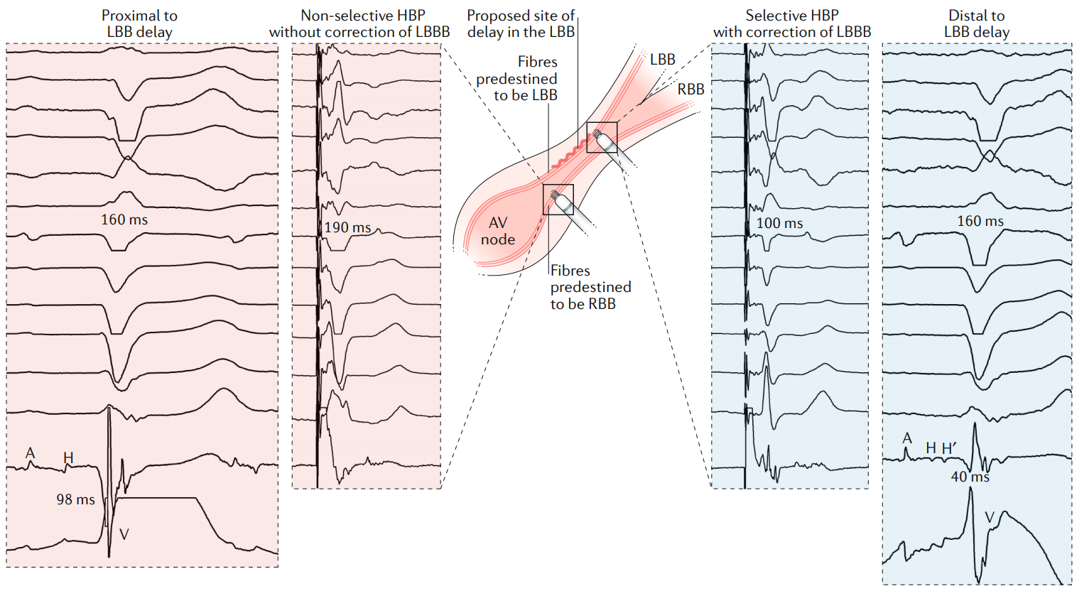
Koncept korektivní stimulace
Hisův svazek = mnohočetná navzájem isolovaná vlákna v jednom „kabelu“
Sharma PS et al. Nat Rev Cardiol 2020;17(1):22-36

Slide 14
Upadhyay GA et a. Circulation 2019; 139(16):1876-1888
Notes:
Put two and two together

Slide 15
Důležité poznamenat všechny hodnoty!
Práh pro NS-HBP (pokud je přítomna)
Typ změny (do S-HBP, do PK stimulace)
Práh pro S-HBP (pokud je přítomna)
Pokud je přítomna LBBB, pak zde je stimulace korektivní, popř. práh pro korektivní stimulaci
Autocapture!!! – OFF
Pro HBP – stimul. výdeje při 1 ms (prahy jsou vyšší)
UP/BP konfigurace
Notes:
If NS and S-HBP thesholds are close to each other (1-2 V) – the final setting of the RV output (= at least 2x of the threshold) may result in NS-HBP, the corrective TH are usually even higher

Slide 16
Koncept stimulace levého raménka

Slide 17
Nevýhody stimulace HS
Zdlouhavé mapování (variabilní anatomie HS)
Skiaskopické a procedurální časy
Vyšší prahy a riziko dalšího nárůstu
< 2V/1ms
Nízký sensing
> 2 mV
Horší stabilita elektrody
Cca 10% akutní selhání, 5-8% mid-term revizí

Slide 18
Liu P et al. Front Cardiovasc Med 2021
Notes:
Komplexní anatomická situace!
Demoulin JC, Kulbertus HE. Histopathological examination of concept of left hemiblock. Br Heart J. (1972) 34:807–14. doi: 10.1136/hrt.34.8.807

Slide 20
45°LAO – hluboké zavedení stimulační elektrody do septa až k endokardu LKS
ke stimulaci levého raménka, kontrastní nástřik ukazuje hranici endokardu PKS

Slide 21
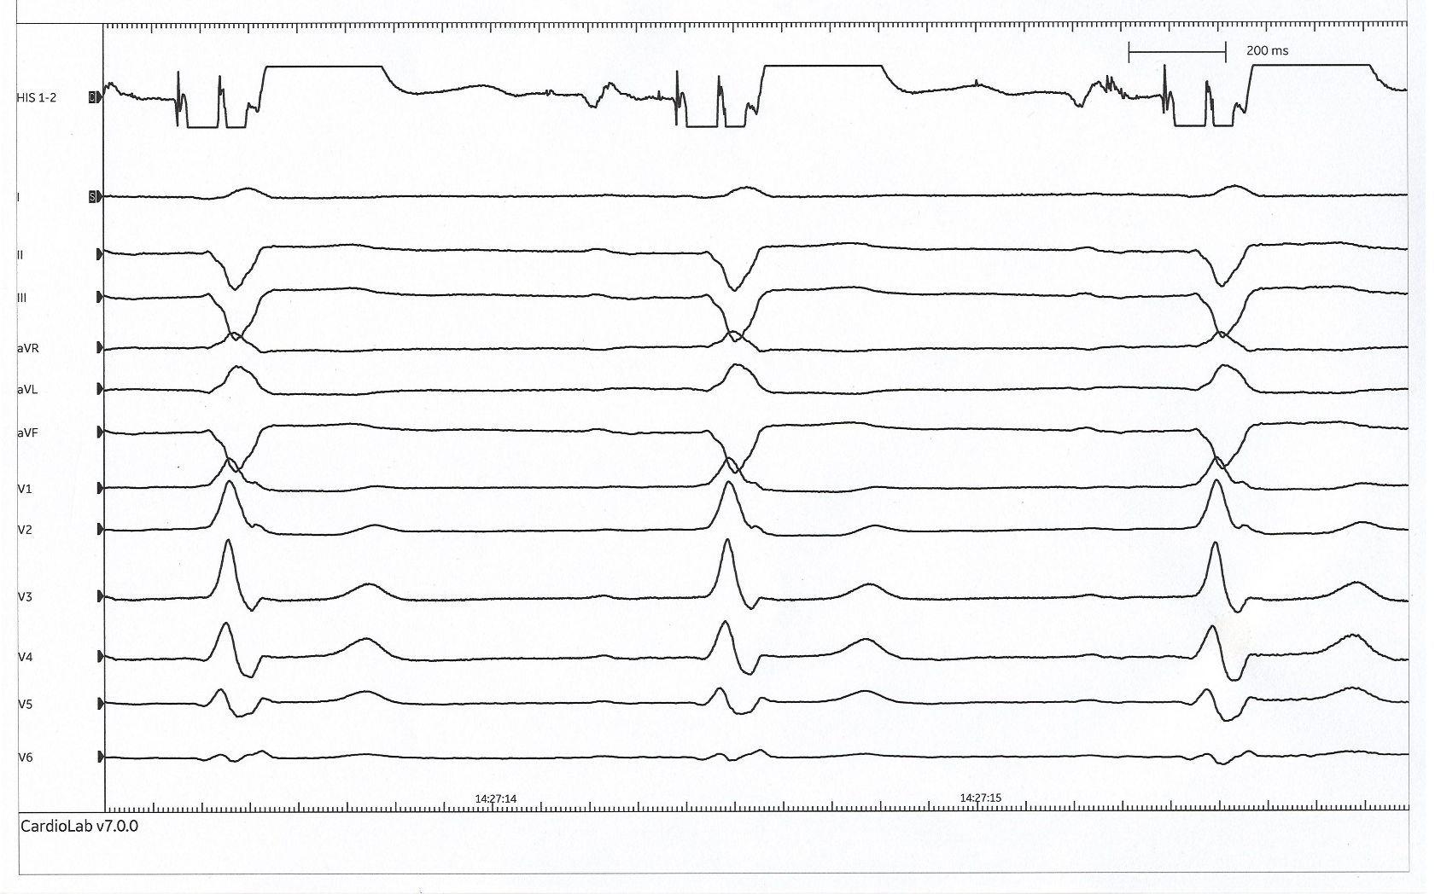
Potenciál levého raménka

Slide 22
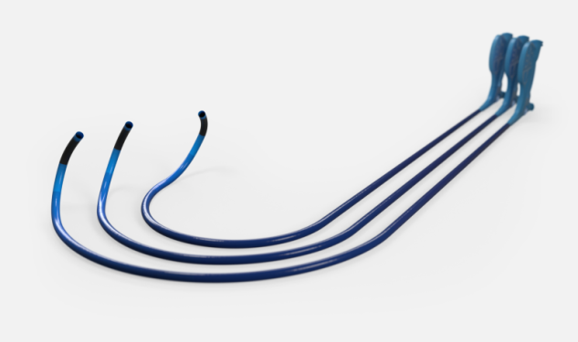
Stimulační instrumentárium

Slide 23
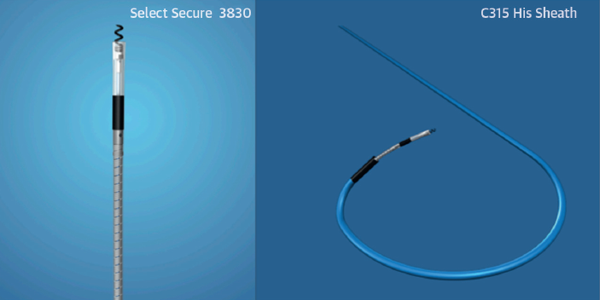
Implantační techniky
SelectSecure 3830, C315His (7 F sheath) or C304 SelectSite (Medtronic)
Notes:
Permanent HBP was initially performed using standard pacing leads by reshaping the stylet or using a deflectable stylet to precisely position the lead at a site near the electrophysiology mapping catheter demonstrating the largest His deflection.
4.1 F, exposed helix, Isodiametric lead body, Lumenless design, 1.8 mm helix

Slide 24
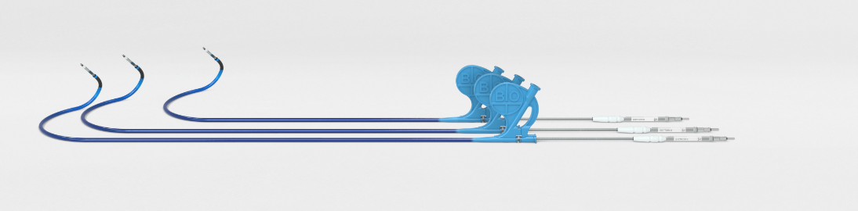
Selectra 3D
Tři křivky a tři délky
Catheter | Selectra 3D
Shaft Diameter, Inner | 2.4 mm (7.3 F)
Shaft Diameter, Outer | 2.9 mm (8.7 F)
Working Length | 32 cm, 39 cm, 42 cm
Proximal Radius* | 40 mm 55 mm 65 mm
55 mm
40 mm
65 mm
Nine Available catheters
Selectra 3D-40-32 Selectra 3D-40-39 Selectra 3D-40-42 | Selectra 3D-55-32 Selectra 3D-55-39 Selectra 3D-55-42 | Selectra 3D-65-32 Selectra 3D-65-39 Selectra 3D-65-42

Slide 25
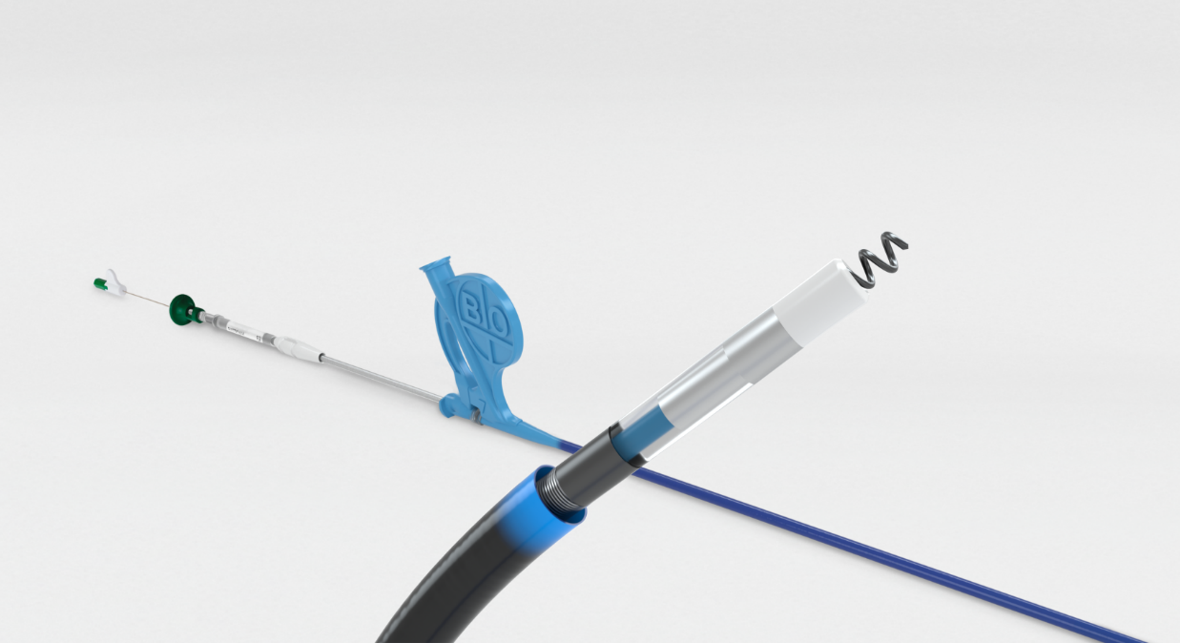
Various stylet choices
Stable distal area due to stylet
Extendable/ retractable screw
Bipolar mapping possible with stylet
Lead | Solia S
Stylet Support | yes
Steroid | Steroid collar Dexamethasone acetate
Lead Body Diameter | 1.8 mm (5.6 F)
Fixation | Extendable/Retractable screw
Length | 53 cm, 60 cm
Helix Length | 1.8 mm
MRI Conditional | 1.5 T and 3.0 T Full-Body Scan
Polarity | Bipolar
Tip-to-Ring Spacing | 10 mm
Connector | IS-1

Slide 26
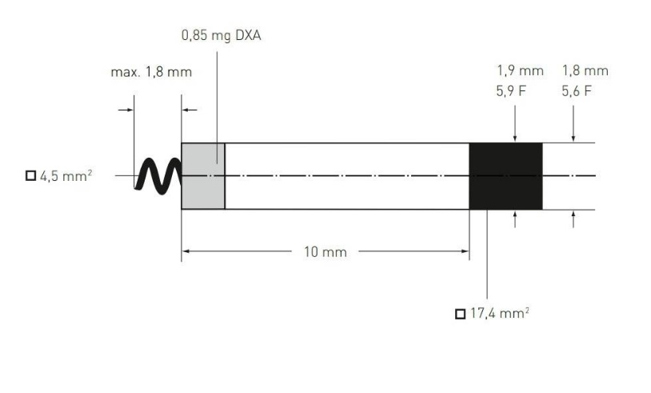

Slide 29
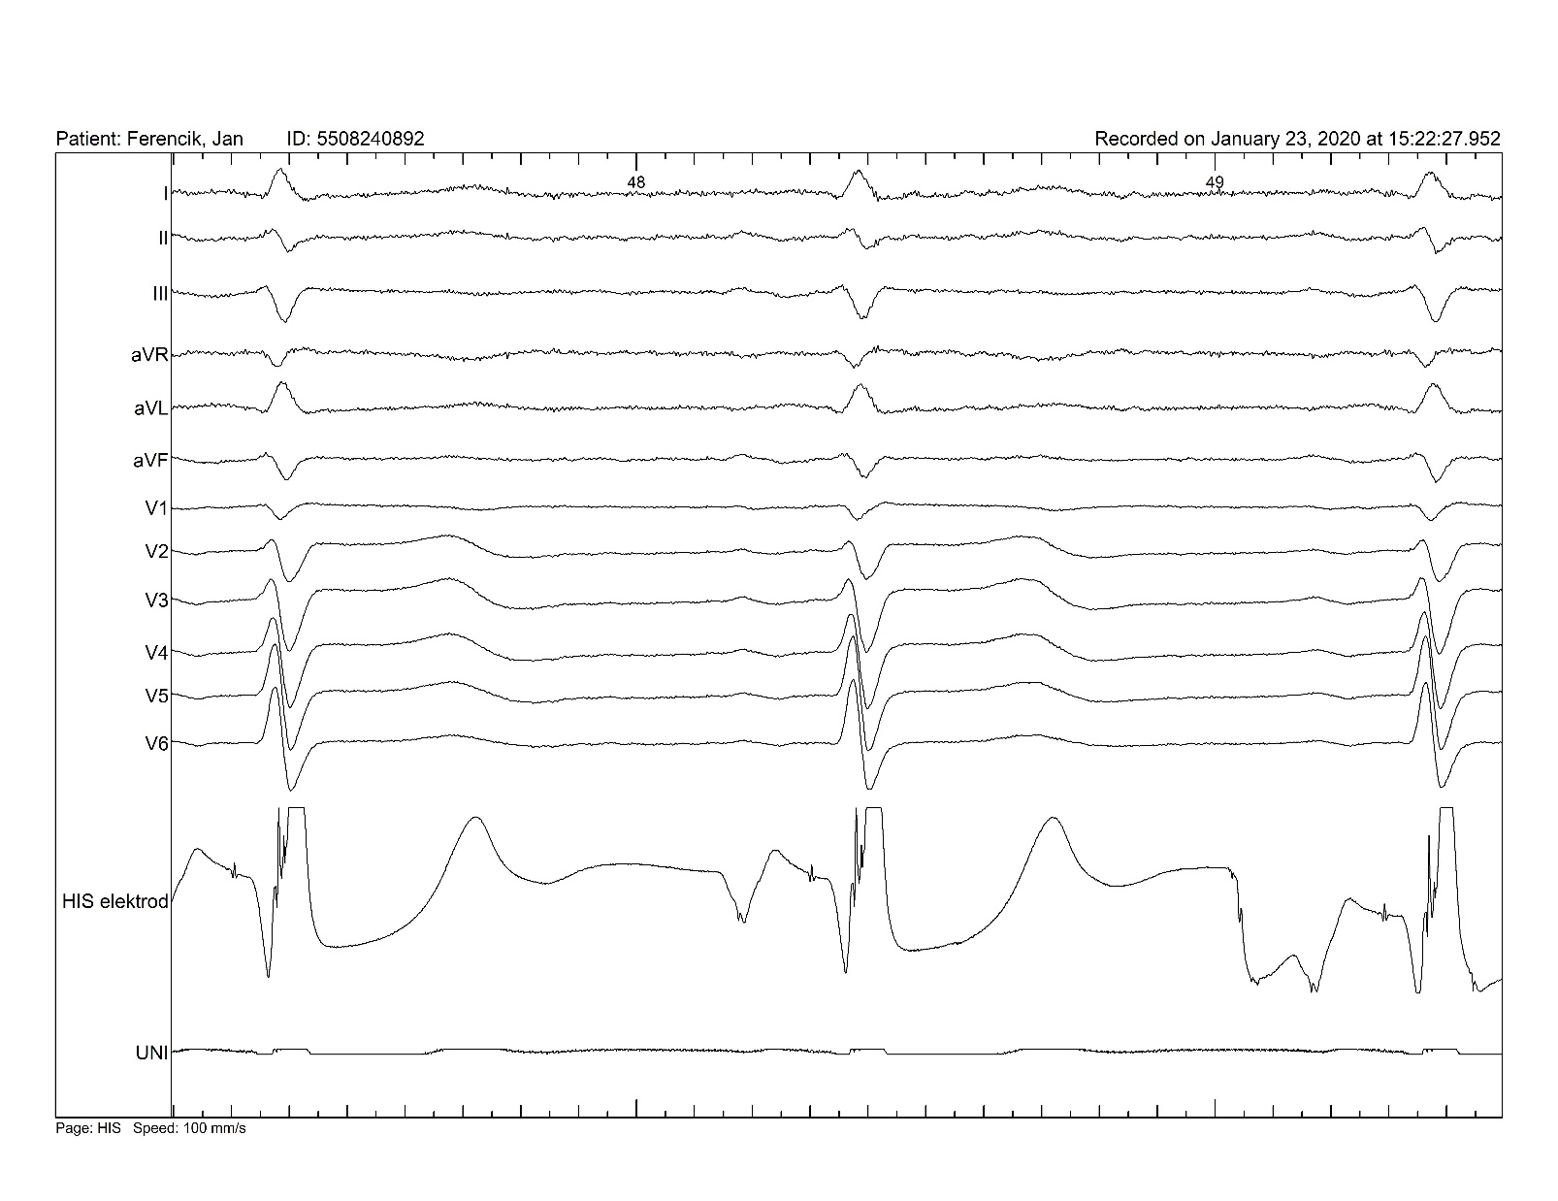

Slide 30
LAO 45°

Slide 32
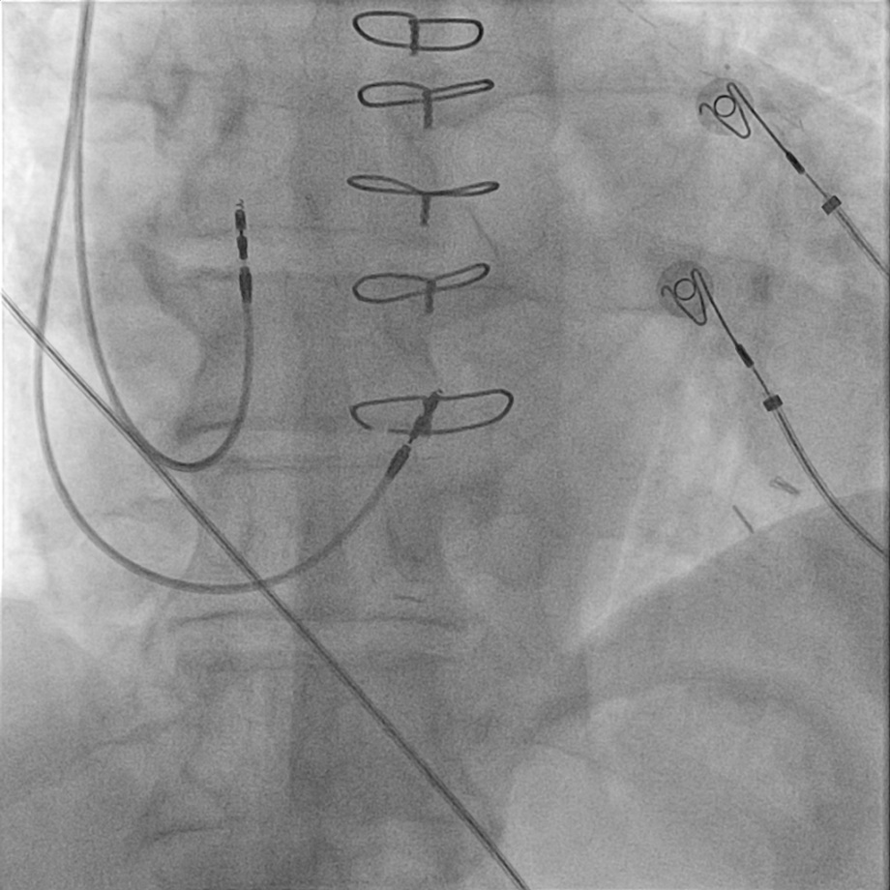
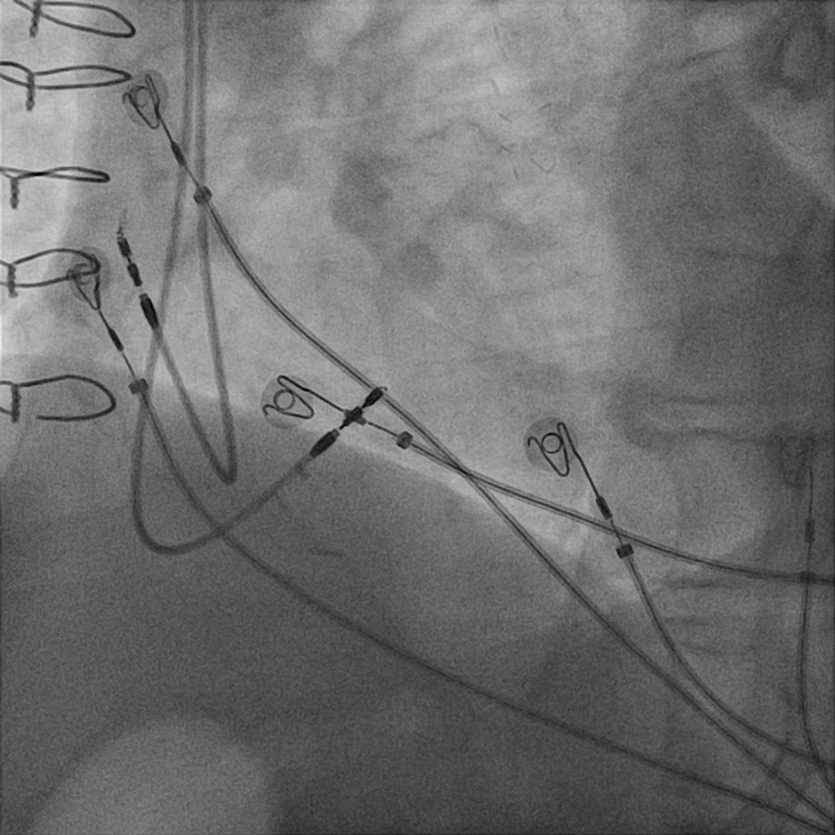
AP
LAO

Slide 34
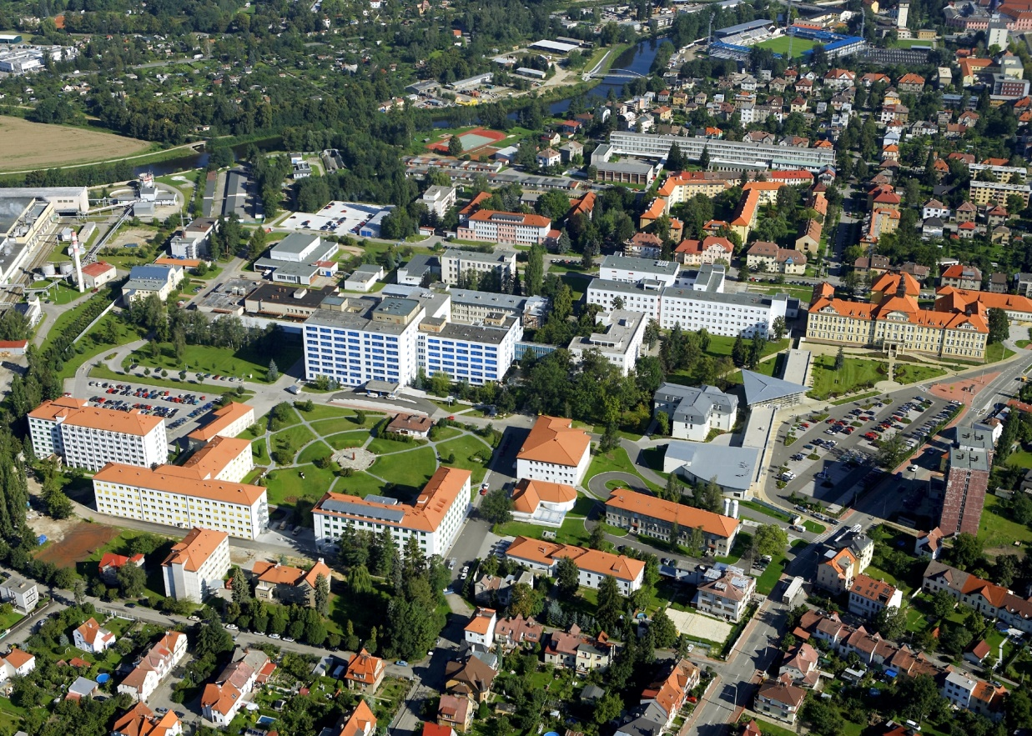
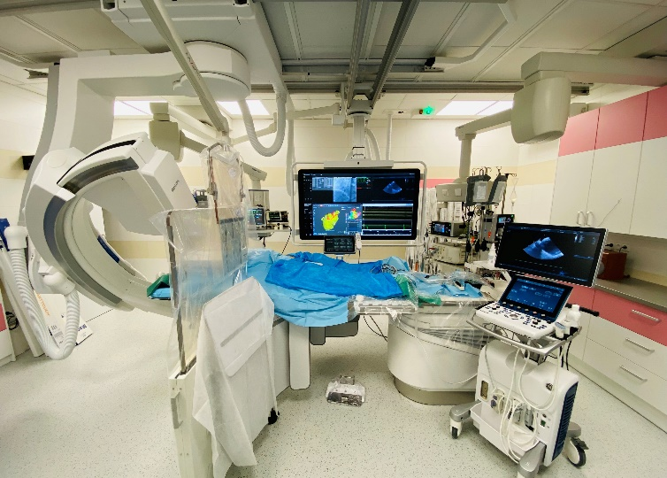
Děkuji za pozvání a za pozornost…
Nemocnice České Budějovice, a.s.
email: alanbulava@seznam.cz

Slide 35
Evidence pro HBP/CSP

Slide 36
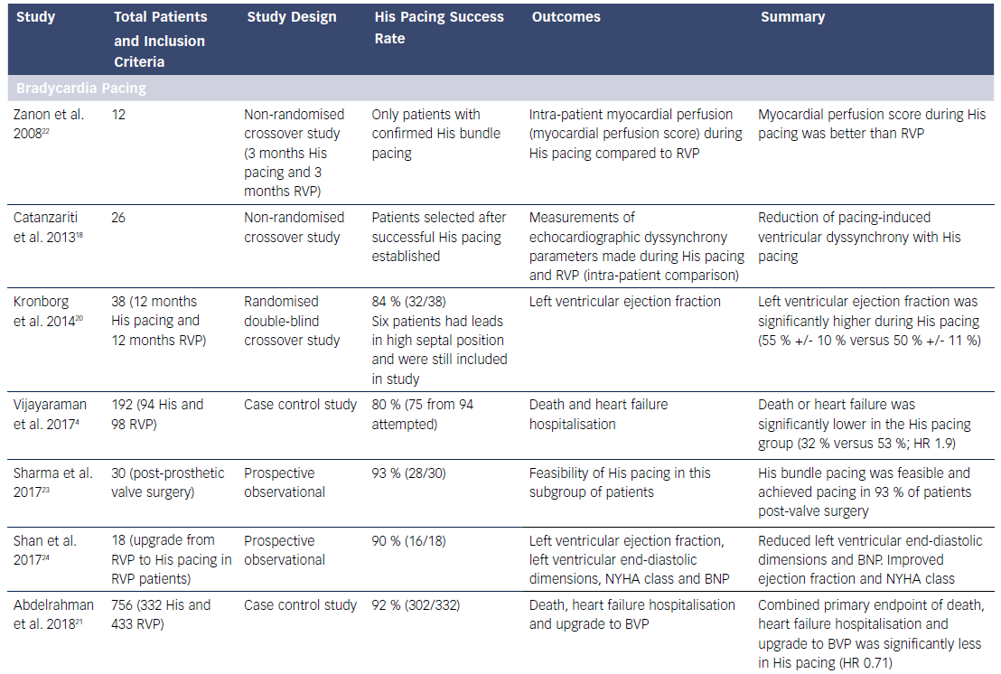
HBP vs. RVA pacing
Notes:
There have been no large randomized controlled-outcome studies comparing His pacing with right ventricular pacing; however, the available data are encouraging
Kronborg: Department of Cardiology, Aarhus University Hospital, Skejby, Brendstrupgaardsvej 100, DK-8200 Aarhus, Denmark Mads.Brix.Kronborg@ki.au.dk.

Slide 37
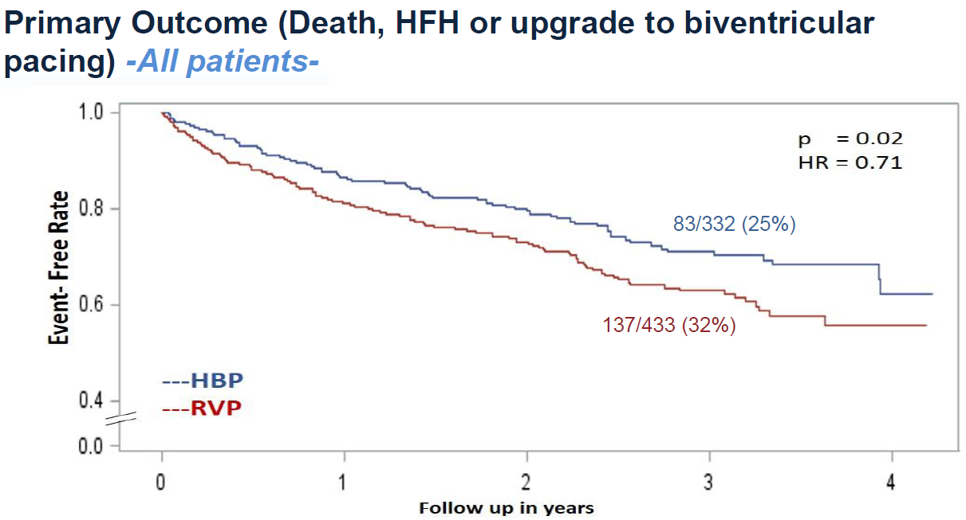
Výsledky z Geisinger HBP Registru
Abdelrahman M et al. J Am Coll Cardiol 2018;71(20):2319-2330
Notes:
Nonrandomized, observational cohort study, Enrollment period: October 2013 to December 2016, all patients undergoing a new permanent pacemaker implantation for bradycardia indications
Geisinger Heart Institute, Wilkes Barre, PA; ‘ Geisinger Heart Institute, Danville, PA; Indiana University, Indianapolis, IN

Slide 38
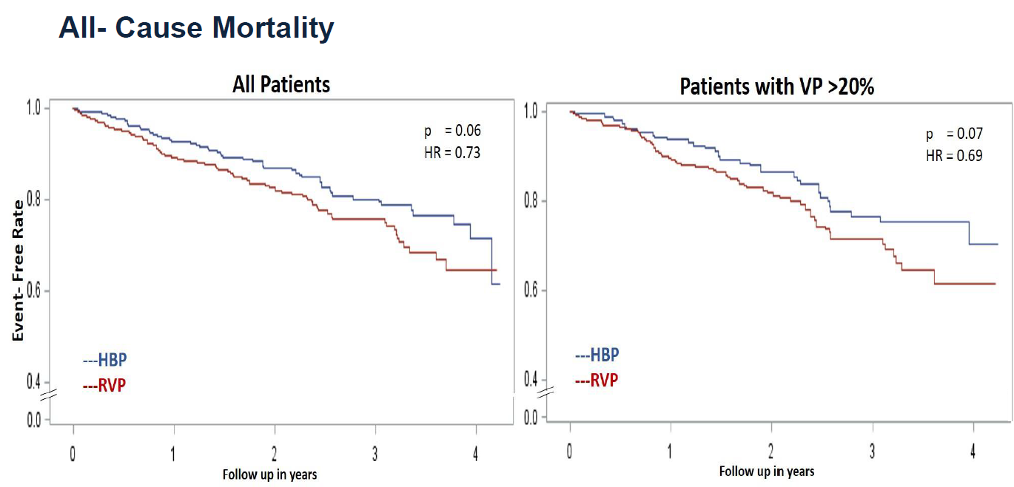
Výsledky z Geisinger HBP Registru
Abdelrahman M et al. J Am Coll Cardiol 2018;71(20):2319-2330

Slide 39
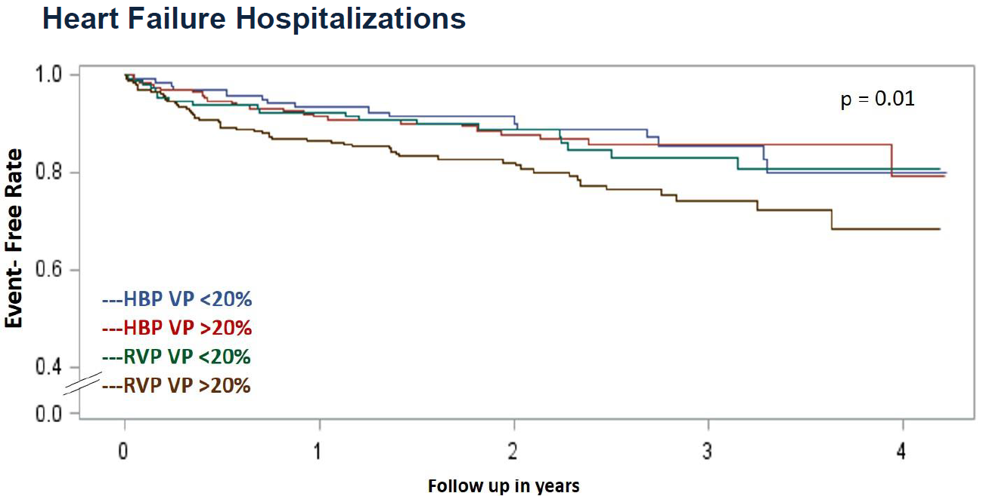
Výsledky z Geisinger HBP Registru
Abdelrahman M et al. J Am Coll Cardiol 2018;71(20):2319-2330

