Slide 1
Léčba fibrilace síní v roce 2021
RATE vs RHYTHM CONTROL
EAST – AFNET 4
Dan Wichterle
Klinika kardiologie IKEM
XVIII. české a slovenské symposium o arytmiích a kardiostimulaci; Olomouc, 7. - 9. 11. 2021

Slide 2
 | Nemám konflikt zájmů | Mám konflikt zájmů | Specifikace konfliktu (vyjmenujte subjekty, firmy či instituce, se kterými Vaše spolupráce může vést ke konfliktu zájmů)
Zaměstnanecký poměr | X
Vlastník / akcionář | X
Konzultant | X
Přednášková činnost | X
Člen poradních sborů (advisory boards) | X
Podpora výzkumu / granty | X
Jiné honoráře (např. za klinické studie či registry) | X

Slide 3
EAST – AFNET 4 Design
Randomization
Patients at risk for cardiovascular events (≈ CHA₂DS₂VASc score ≥ 2)
and with recent onset atrial fibrillation (≤1 year since documented by ECG)
Early Rhythm Control
anticoagulation
rhythm control
escalation of AADs
AF ablation / reablation
Usual Care
anticoagulation
rate control
Kirchhof P et al. N Engl J Med 2020;383(14):1305-16.
Notes:
EAST – AFNET 4 randomized patients at cardiovascular risk, approximated by a CHASDSVASc score of 2 or more,

Slide 4
EAST – AFNET 4 Baseline Characteristics
Věk | 70 let
Ženy | 46 %
CHA₂DS₂-VASc Score | 3.4
Srdeční selhání (NYHA≥2, EF LK <50%) | 29 %
První epizoda FiS | 38 %
Doba od dokumentace FiS | 36 dnů
Asymptomatická FiS (EHRA I) | 30 %
Notes:
Patient characteristics were well balanced between randomized grroups. Mean age was 70 years, almost half of the patients (46%) were female. The mean CHADSVASC score was 3.4 and 29% had stable heart failure.

Slide 5
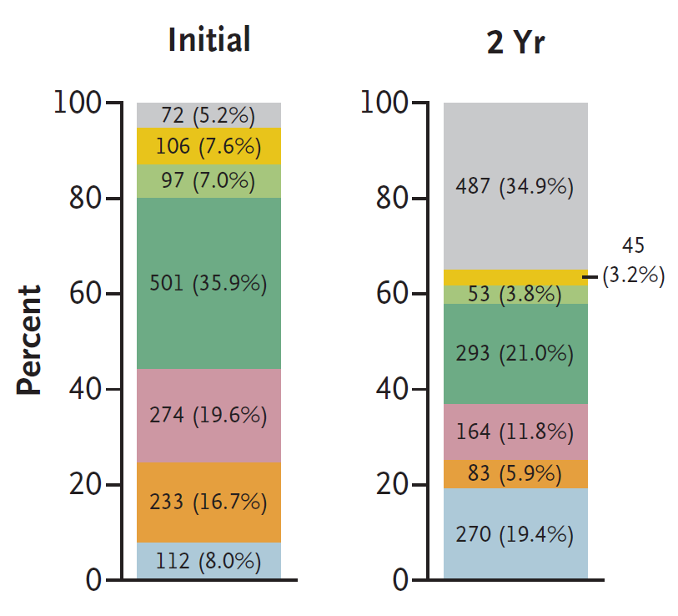
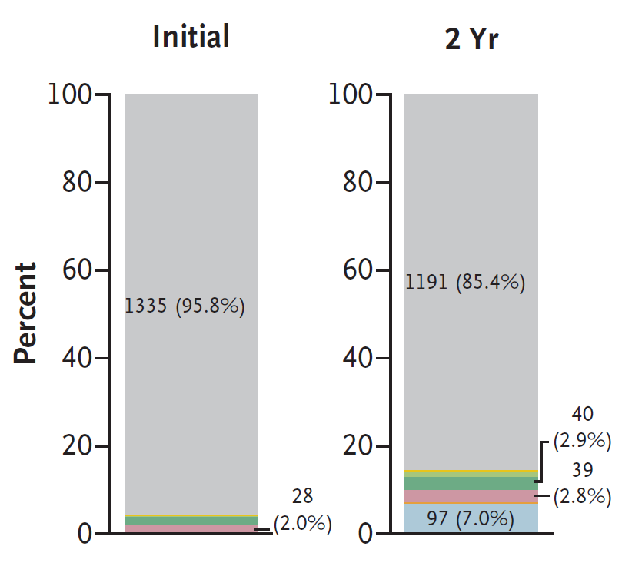
Randomization
EAST – AFNET 4 Treatment and follow-up
2789 patients randomized by 135 sites in 11 countries
Early Rhythm Control (n=1,395)
Usual Care (n=1,394)
Included in primary analysis n=1,395
Included in primary analysis n=1,394
Median follow-up 5.1 let
Total FU-years lost: 9.0%
Withdrawal: 6.9%
Lost: 2.1%
Total FU-years lost: 6.6%
Withdrawal: 4.5%
Lost: 2.0%

Slide 6
EAST – AFNET 4 Primary outcomes
1st primary outcome
cardiovascular death
stroke or transient ischemic attack (with matching lesion)
hospitalizations
for worsening of heart failure
for acute coronary syndrome
2nd primary outcome
nights spent in hospital per year

Slide 7
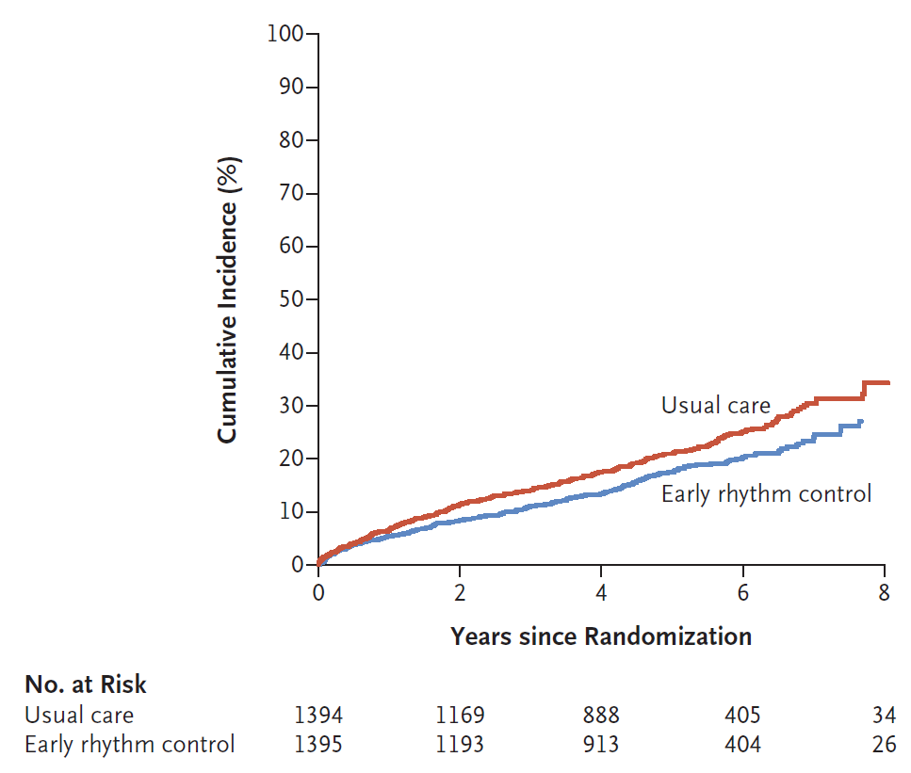
EAST – AFNET 4 First primary outcome
5.0% / year
Absolutní pokles rizika
-1.1% / rok
NNT
91 pacientů
po dobu 1 roku
HR = 0.79 (95%CI: 0.66-0.94)
3.9% / year

Slide 8
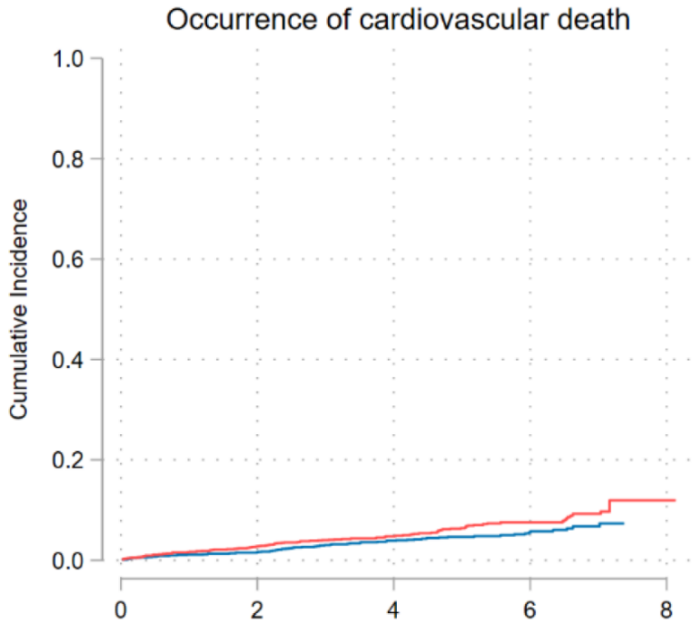
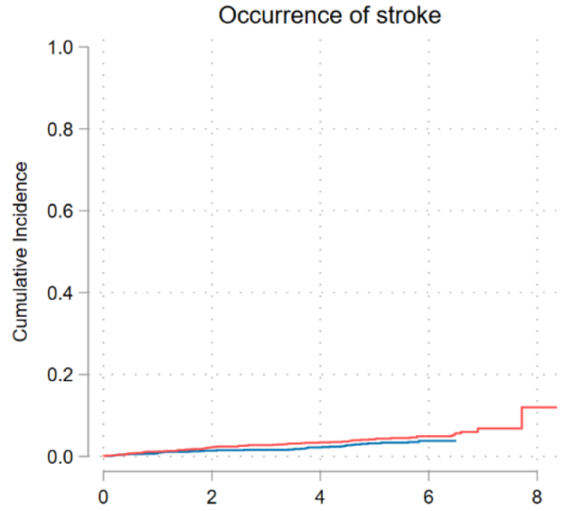
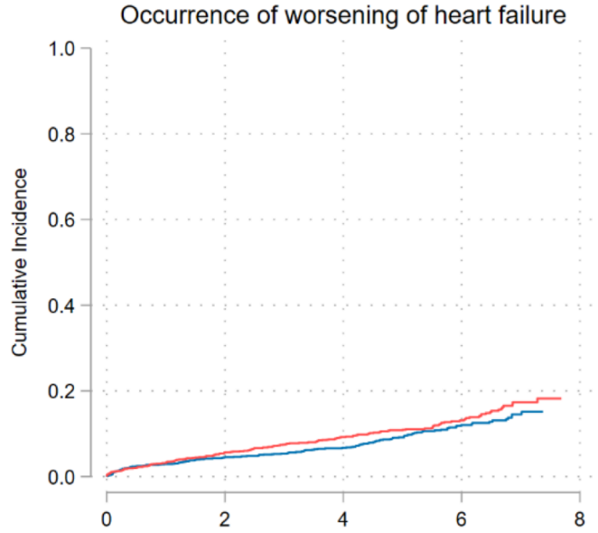
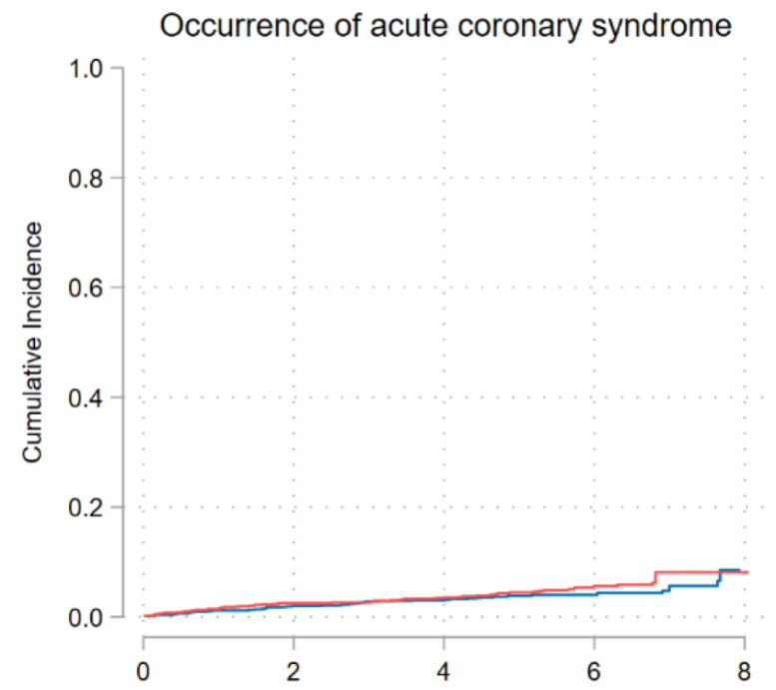
EAST – AFNET 4 Components of first primary outcome
Abs. riziko
-0.3% / rok
NNT = 333
Abs. riziko
-0.3% / rok
NNT = 333
1.3% / year
0.9% / year
HR = 0.72 (95%CI: 0.52-0.98)
HR = 0.65 (95%CI: 0.44-0.97)
1.0% / year
0.6% / year
Abs. riziko
-0.5% / rok
NNT = 500
2.6% / year
1.0% / year
Abs. riziko
-0.2% / rok
NNT = 500
HR = 0.81 (95%CI: 0.65-1.02)
HR = 0.83 (95%CI: 0.58-1.19)
2.1% / year
0.8% / year

Slide 9
EAST – AFNET 4 Second primary outcome
 | Early Rhythm Control (n=1395) | Usual Care (n=1394) | Treatment Effect
 | Mean ± SD |  | Incidence rate ratio [99% CI]
Nights spent in hospital per year | 5.8 ± 21.9 | 5.1 ± 15.5 | 1.08 [0.92-1.28]
Notes:
Revision figure

Slide 10
EAST – AFNET 4 Key secondary outcomes (at 24 months)
 | Early Rhythm Control (n=1395) | Usual Care (n=1394) | Treatment Effect
 | Mean ± SD |  | Adjusted mean difference [95% CI]
Change in LVEF | 1.5% ± 9.8% | 0.8% ± 9.8% | 0.23% [-0.46%; 0.91%]
Change in EQ-5D (VAS state of health) | -1.0 ± 21.4 | -2.7 ± 22.3 | 1.07 [-0.68; 2.82]
Change in SF-12 Mental Score | 0.7 ± 10.6 | 1.6 ± 10.1 | -1.20 [-2.04; -0.37]
Change in SF-12 Physical Score | 0.3 ± 8.5 | 0.1 ± 8.2 | 0.33 [-0.39; 1.06]
Change in MoCA score | 0.1 ± 3.3 | 0.1 ± 3.2 | -0.14 [-0.39; 0.12]
Notes:
Revision figure

Slide 11
EAST – AFNET 4 Safety Outcomes
 | Early Rhythm Control | Usual Care
Primary safety outcome | 231 (16.6%) | 223 (16.0%)
Occurrence of stroke | 40 (2.9%) | 62 (4.4%)
Occurrence of death | 138 (9.9%) | 164 (11.8%)
SAE related to rhythm control | 68 (4.9%) | 19 (1.4%)
Non-fatal cardiac arrest | 1 (0.1%) | 1 (0.1%)
Toxicity of AF-related drugs | 10 (0.7%) | 3 (0.2%)
Drug-induced bradycardia | 14 (1.0%) | 5 (0.4%)
AV block | 2 (0.1%) | 0 (0.0%)
Torsade de Pointes tachycardia | 1 (0.1%) | 0 (0.0%)
SAE related to AF ablation
Pericardial tamponade | 3 (0.2%) | 0 (0.0%)
Bleeding, major | 6 (0.4%) | 0 (0.0%)
Bleeding, non-major | 1 (0.1%) | 2 (0.1%)
Other SAE related to rhythm control
Blood pressure related | 1 (0.1%) | 0 (0.0%)
Hospitalization for AF | 11 (0.8%) | 3 (0.2%)
Other cardiovascular event | 5 (0.4%) | 1 (0.1%)
Other event | 1 (0.1%) | 3 (0.2%)
Syncope | 4 (0.3%) | 1 (0.1%)
Hospitalization for worsening of HF | 3 (0.2%) | 0 (0.0%)
Implant of PM/ICD or other device | 8 (0.6%) | 4 (0.3%)
 | Early Rhythm Control | Usual Care
Primary efficacy outcome | 249 (17.9%) | 316 (22.7%)
CV death | 67 (4.8%) | 94 (6.7%)
Stroke | 40 (2.9%) | 62 (4.4%)
Hospitalization for HF | 139 (10.0%) | 169 (12.1%)
Hospitalization for ACS | 53 (3.8%) | 65 (4.7%)
4.9%
1.4%
17.9%
22.7%
2.0%
0.7%
21.5%
27.9%
0.7%
0.1%
Absolutní vzestup rizika
+3.5%
Absolutní pokles rizika
-4.8%
2.5%
0.9%
Notes:
Early rhythm control was safe. The primary safety outcome, a composite of stroke, death, and serious adverse events related to rhythm control therapy, occurred in 231 …..
Stroke was less common in patients randomized to early rhythm control.
Mortality was less common, but the difference was not significant between groups.
Serious adverse events related to rhythm control therapy were rare, but less common in patients randomized to usual care.
28 patients experienced serious adverse events related to antiarrhythmic drug therapy, and 10 events related to AF ablation (9 and 2 in the usual care group).

Slide 12
EAST – AFNET 4 Net benefit
 | Early Rhythm Control | Usual Care
SAE related to rhythm control | 71 (5.1%) | 23 (1.6%)
 | Early Rhythm Control | Usual Care
Primary efficacy outcome | 299 (21.4%) | 390 (28.0%)
Absolutní vzestup rizika
+3.5%
Absolutní pokles rizika
-6.6%
Notes:
Early rhythm control was safe. The primary safety outcome, a composite of stroke, death, and serious adverse events related to rhythm control therapy, occurred in 231 …..
Stroke was less common in patients randomized to early rhythm control.
Mortality was less common, but the difference was not significant between groups.
Serious adverse events related to rhythm control therapy were rare, but less common in patients randomized to usual care.
28 patients experienced serious adverse events related to antiarrhythmic drug therapy, and 10 events related to AF ablation (9 and 2 in the usual care group).

Slide 13
EAST – AFNET 4 S u m m a r y
Strategie kontroly rytmu u rizikovějších pacientů s recentním záchytem fibrilace síní:
statisticky významně snižuje výskyt kombinace:
(1) kardiovaskulárního úmrtí
(2) ischemické CMP
(3) hospitalizace pro srdeční selhání nebo akutní koronární syndrom
při posthoc testování významně snižuje i výskyt obou prvních položek kombinovaného endpointu
vede k více než 3-násobnému nárůstu závažných nežádoucích účinků (nezanedbatelné absolutní procento) v příčinné souvislosti s antiarytmickou a ablační léčbou

Slide 15
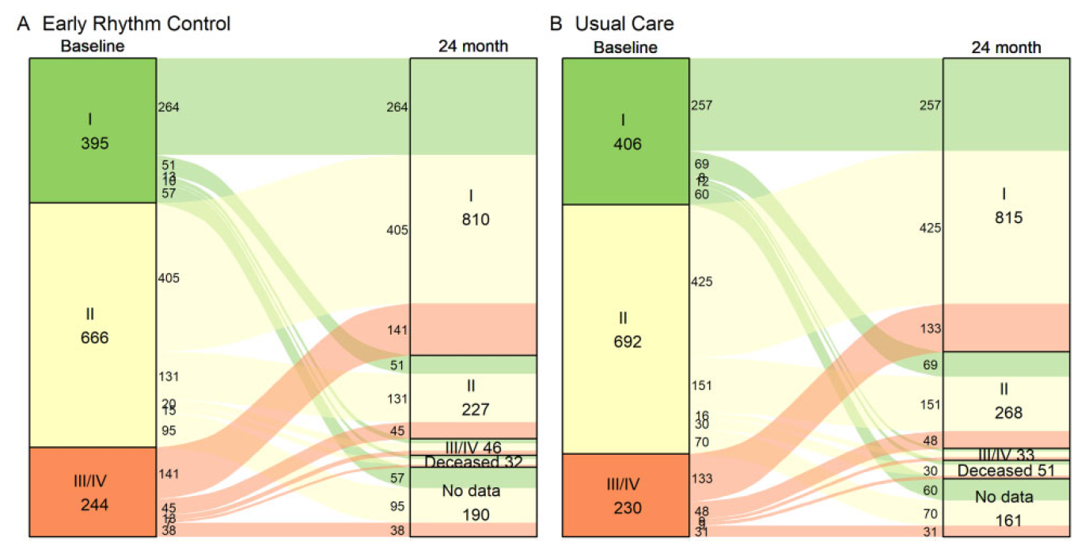
EAST – AFNET 4 Symptoms
Willems S et al. Eur Heart J 2021; doi:10.1093/eurheartj/ehab593.

Slide 16
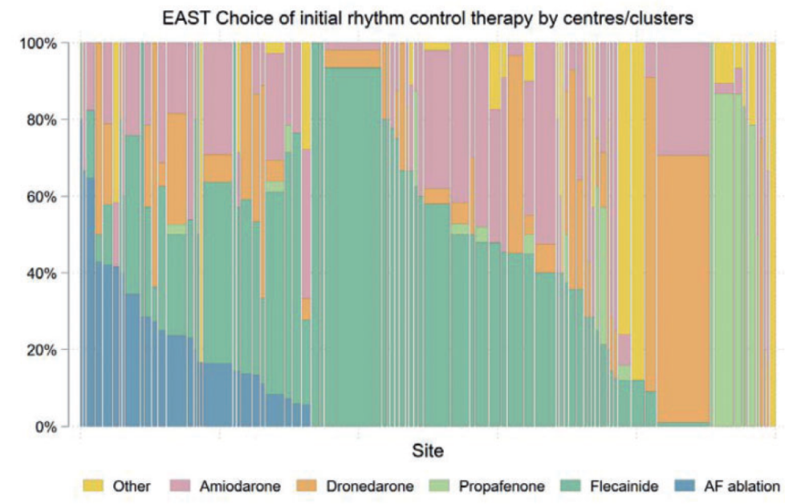
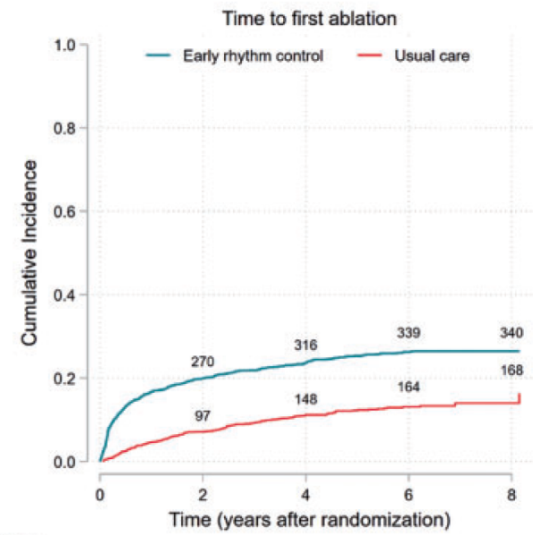
EAST – AFNET 4 Rhythm control strategy
Metzner A et al. Europace 2021; doi:10.1093/europace/euab200.

Slide 17
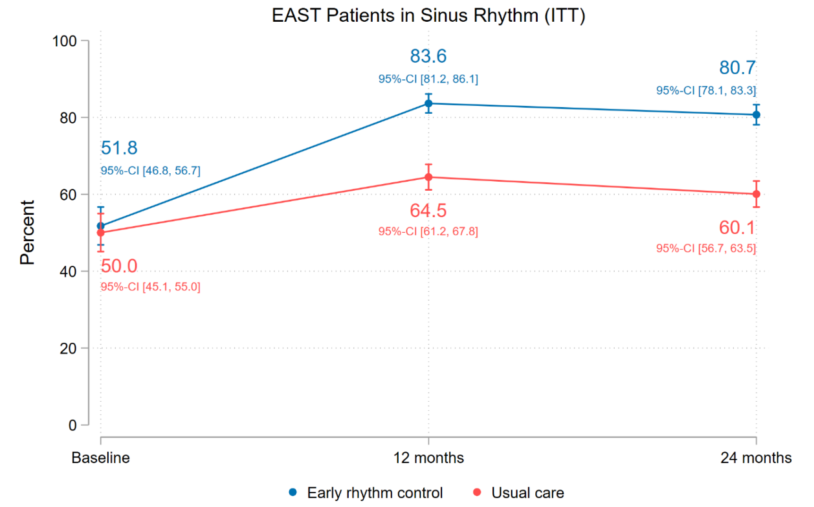
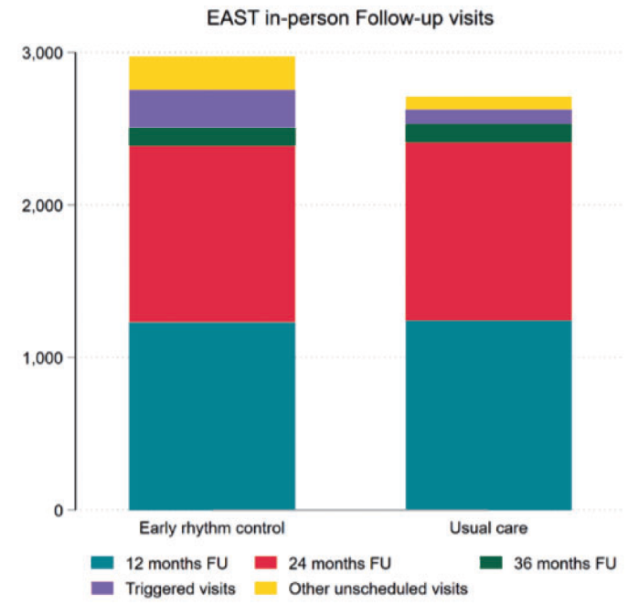
EAST – AFNET 4 Sinus rhythm and follow-up visits
Metzner A et al. Europace 2021; doi:10.1093/europace/euab200.

Slide 18
EAST – AFNET 4 Baseline Characteristics
 |  | Early Rhythm Control (n=1395) | Usual Care (n=1394)
Age [years] |  | 70.2 ± 8.4 | 70.4 ± 8.2
Female sex |  | 645 (46.2%) | 648 (46.5%)
Weight [kg] |  | 85.0 ± 18.4 | 85.0 ± 18.2
CHA₂DS₂-VASc Score [N=2784, Mean ± SD] |  | 3.4 ± 1.3 | 3.3 ± 1.3
Stable heart failure (NYHA stage II-III or LVEF < 50%) |  | 396 (28.4%) | 402 (28.8%)
Atrial Fibrillation Characteristics
Type of AF | First episode | 528/1391 (38.0%) | 520/1394 (37.3%)
 | Paroxysmal | 501/1391 (36.0%) | 493/1394 (35.4%)
 | Persistent | 362/1391 (26.0%) | 381/1394 (27.3%)
Sinus rhythm at baseline |  | 762/1389 (54.9%) | 743/1393 (53.3%)
Time since AF diagnosis (days, Median [IQR]) |  | 36.0 [6.0; 114.0] | 36.0 [6.0; 112.0]
Without AF-related symptoms (EHRA score I) |  | 395/1305 (30.3%) | 406/1328 (30.6%)
Medication at Discharge
Oral anticoagulation (NOAC or VKA) |  | 1267/1389 (91.2%) | 1250/1393 (89.7%)
Digoxin or Digitoxin |  | 46/1389 (3.3%) | 85/1393 (6.1%)
Beta blockers |  | 1058/1389 (76.2%) | 1191/1393 (85.5%)
ACE inhibitors, angiotensin II receptor blocker, or neprilysin/valsartan |  | 953/1389 (68.6%) | 979/1393 (70.3%)
Statins |  | 628/1389 (45.2%) | 568/1393 (40.8%)
Platelet inhibitors |  | 229/1389 (16.5%) | 226/1393 (16.2%)
Notes:
Patient characteristics were well balanced between randomized grroups. Mean age was 70 years, almost half of the patients (46%) were female. The mean CHADSVASC score was 3.4 and 29% had stable heart failure.

Slide 19
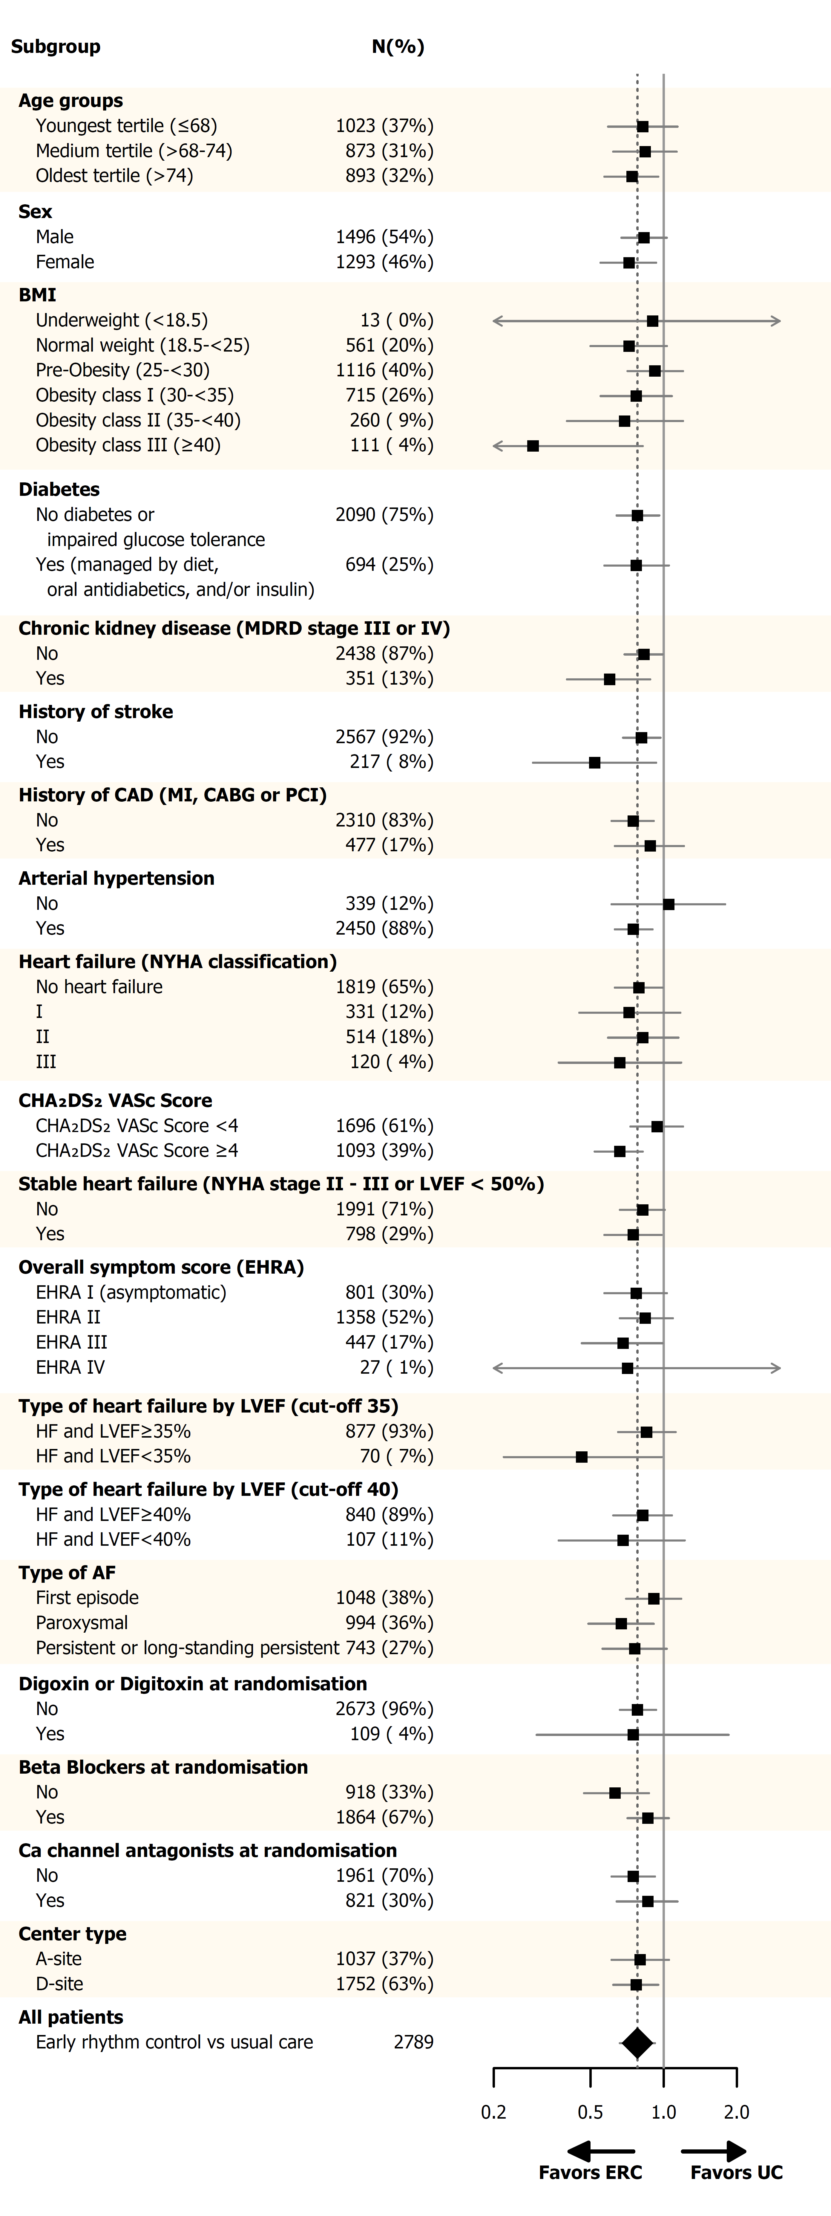
EAST – AFNET 4 First primary outcome by subgroups
Notes:
The effect of early rhythm control was consistent across 19 clinical subgroups without significant interactions, including in asymptomatic patients and in those with and without heart failure..

Slide 20
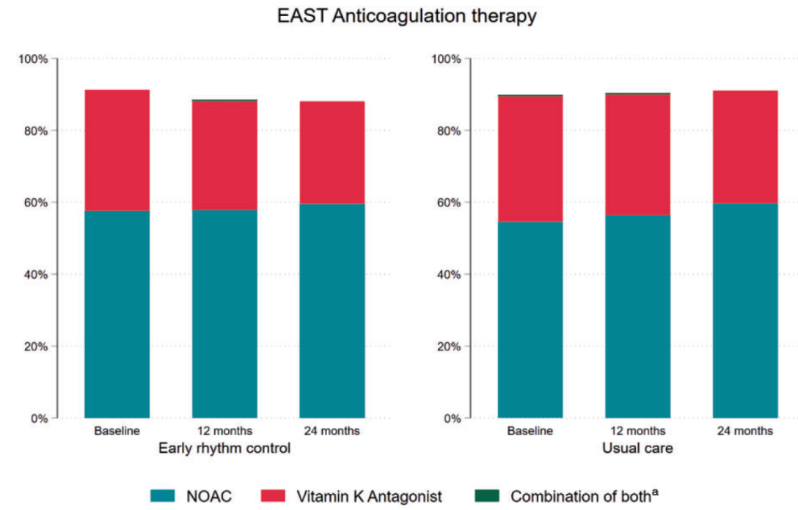
EAST – AFNET 4 Anticoagulation
Metzner A et al. Europace 2021; doi:10.1093/europace/euab200.

Slide 21
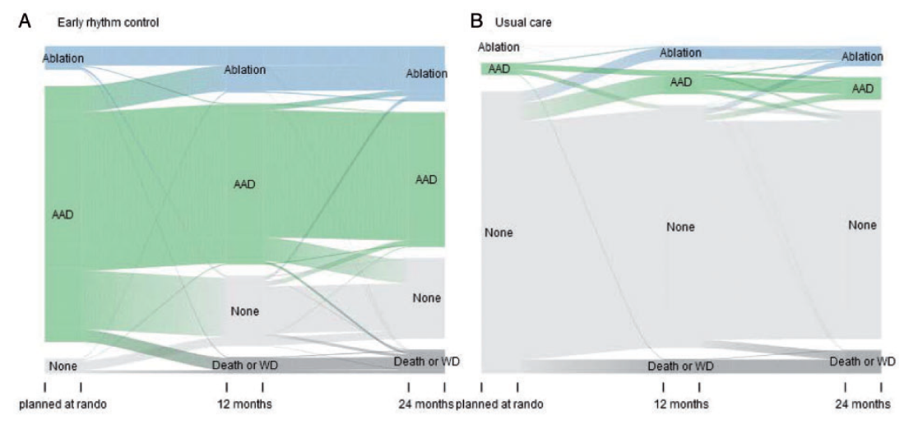
EAST – AFNET 4 Other
Metzner A et al. Europace 2021; doi:10.1093/europace/euab200.

Slide 22
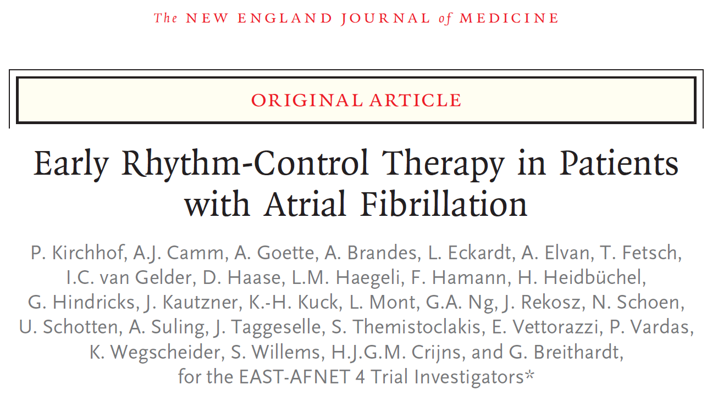
EAST – AFNET 4
Kirchhof P et al. N Engl J Med 2020;383(14):1305-16.

